Slide 1
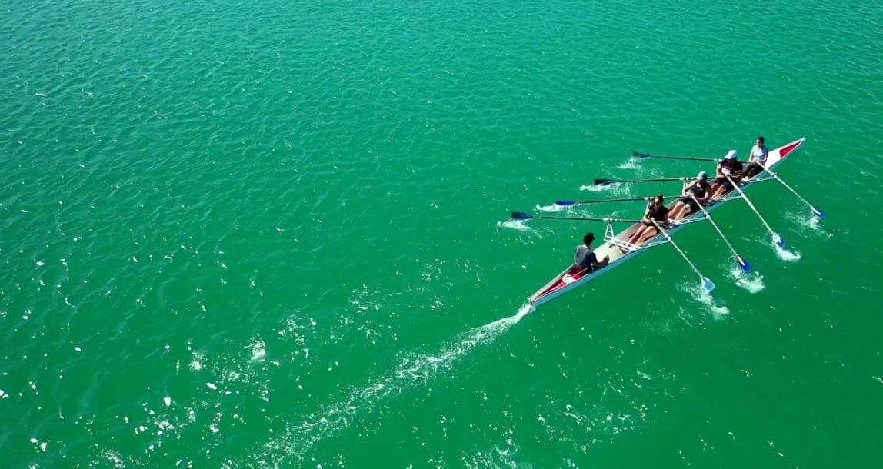
Transforming IT
INFRASTRUCTURES
Dream big.
Compete fiercely.
Innovate with Intelligence.
And Let CPP Associates be the Technology Partner to Support You Along the Way.

Slide 2
Here’s What We’ll Cover Today:
Who is CPP Associates?
Four Primary Practice Areas:
Infrastructure/Networking Solutions
Data Intelligence Solutions
Network Security Solutions
Managed Services
Next Steps

Slide 3
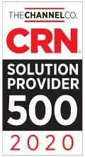
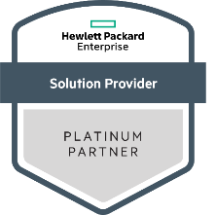
Who is CPP?
Founded in 2016 by partners Pat O’Dell (General Manager), Dan Hogan (Director of Operations) and Paul O’Dell (Director of Sales); based in Clinton, NJ
Approach is based on an Assess, Design, Implement and Management (ADIM) methodology to help customers successfully implement complex infrastructure projects such as Storage Area Networks, Enterprise Backup, Disaster Recovery and Business Continuity solutions
Fast growing, award-winning company with an outstanding reputation for customer service and success
U.S. Solutions Provider of the Year 2020

Slide 4
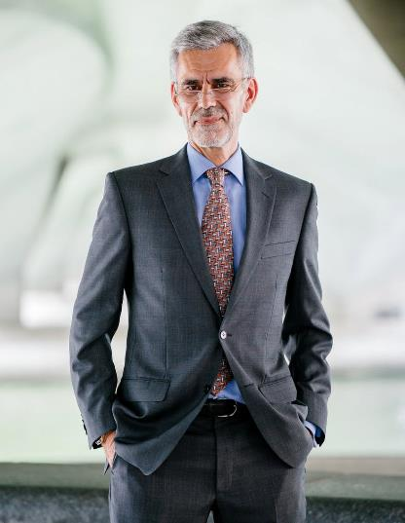
Guiding Principle:
“Technical infrastructure is essential to everything. It will accelerate all good and all bad trends.
For these very reasons, the human element becomes more important. High tech without high touch does not work. The more influential technology becomes, the more important the human factor which controls that technology becomes.
Remember, technology is a great servant, but a terrible master.”
Stephen Covey, renowned educator, author, business leader
“Seven Habits of Highly Successful People

Slide 5
Who is CPP?
Key Differentiators
2 : 1
Engineering staff to Sales Staff Ratio (typically the reverse in other VARs)
Consistent technical lead
(“whiteboard to keyboard”) throughout projects/engagements
Deep, long-standing relationships with OEMs provides an “inside track” and concierge-level support
Maniacal focus on “company first” approach with a stringent analytical focus and vendor agnostic perspective

Slide 6
Primary Solution Practices
IT Infrastructure/ Networking
Network Security
Data Intelligence
Managed Services

Slide 7
IT Infrastructure/Networking
Company First, Not Cloud First.
Company First is a Strategy; Cloud First is a Tactic.
What if:
You could decrease IT spend by 30% AND
Improve application performance/user experience AND
Reduce risk to the organization?
Would you do it?

Slide 8
The Digital Enterprise is Changing
Ops driven
Cost focused
Apps driven
Agility focused
Traditional Apps
Cloud Native Apps
Traditional
IT
Private clouds
Public cloud 1
Private clouds
Public cloud 1
Public cloud 2
Too complex
Too disconnected
The Management of Workloads Across Multiple Platforms is Today’s Most Pressing Infrastructure Challenge.

Slide 9
Cloud Comparisons
 | Annual Cost PROD and DR in the Public Cloud (in thousands USD) |  |  | Annual Cost PROD: GreenLake DR: DRaaS (in thousands USD) | Annual Cost PROD: Owned DR: DRaaS (in thousands USD)
Item | AWS | Azure | Google | 80% Target | Over 4 Years
PROD compute (incl labor on-prem) | $289 | $276 | $248 | $ - | $188
PROD storage (incl labor on-prem) | $84 | $84 | $141 | $ - | $99
PROD storage + compute | $373 | $360 | $389 | $341 | $287
Cloud migration costs ² | $147 | $147 | $147 | $ - | $ -
End-user data egress | $3 | $3 | $3 | $ - | $ -
On-premises networking mgmt | $ - | $ - | $ - | $18 | $18
Data center power, cooling, rack space | $ - | $ - | $ - | $71 | $71
Total Annual PROD Cost | $523 | $510 | $539 | $430 | $376
DR replication egress | $28 | $27 | $30 | $ - | $ -
DR solution ³ | $140 | $164 | $156 | $150 | $150
DR periodic testing | $23 | $22 | $22 | $30 | $30
Total Annual DR Cost | $191 | $213 | $208 | $179 | $179
TOTAL PROD and DR | $714 | $712 | $747 | $609 | $555
What do you want to accomplish with Cloud?
PROD on-prem, DR in the cloud
Saving money may not be the answer!
(1) Amortized costs over 4 years. Cost of money, depreciation factors not considered.
(3) For PROD in the public cloud, DR is based on AWS CloudEndure
(2) Cloud migration costs amortized costs over 3 years
(4) GreenLake Virtualization as a Service, 4-year contract, 80% of target infrastructure consumed

Slide 10
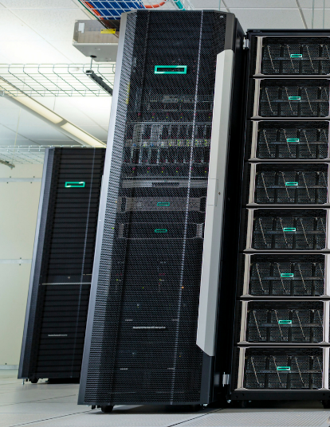
CPP Vision - Software Defined Data Center
“Data Center Anywhere”
You can achieve “cloud-like” benefits
Agility/Elasticity
Automation
Availability
Self Service/Ease of Use
Performance and Security
Financial Models that enable Revenue to Increase and/or Cost to Decrease
In a more cost-effective model with a Hybrid Cloud Infrastructure

Slide 11
CPP SDDC – How do we enable a Hybrid Approach?
S
E
C
U
R
I
T
Y
N E T W O R K
Software Defined Data Center
Automation
VMWare
Citrix
Red Hat
Containers
Microsoft
AHV
Public Cloud
HPE Software Defined
Compute/Storage Tools
Open, support any path or multiple paths in efficient way
Hybrid
Public Cloud (AWS, Azure, Google)
Various IaaS CSPs
SaaS (O365, GSuite) SFDC)
Fluid

Slide 12
Primary Solution Practices
IT Infrastructure/ Networking
Network Security
Data Intelligence
Managed Services

Slide 13
Data Intelligence
Data intelligence will fuel the future of business. Where does your company stand?
3 out of 4
business executives believe that their organizations will fail in the next five years without a successful AI initiative.
500+
Business & technical choices that need to be made with every AI initiative
4 out of 5 AI
Initiatives under development fail to launch.
Success in the Data Intelligence Market Comes Down to a Straightforward Mathematical Equation.

Slide 14
Do the Math
3 out of 4 C level Executives believe they will need multiple AI Initiatives to survive over the next 3 years.
Up to 80% all AI initiatives fail to deliver value to the organization.
Hundreds (if not thousands) of choices at multiple points.
Need to have 15 initiatives to have 3 successful ones if 80% fail.
15 initiatives times 300 choices (conservative).
4,500 decisions (small and large) need to be made.
It’s the reason why we are doing what we are doing.
Need to improve your stats and ratios or costs will skyrocket (human, technology expenses).
(3x5)
x
300
=
4500
Many AI Initiatives fail to launch or launch and fail because of this equation

Slide 15
CPP Data Intelligence Practice
Edge to Cloud Solutions to transform legacy warehouses/environments utilizing today’s most innovative data intelligence solutions.
Uncover valuable insights that drive business
Align business needs across the enterprise
Automate processes
Lower operational costs
Reveal new revenue streams
Increase security and compliance
Maintain a competitive advantage

Slide 16
How to Get Started on Your DI Journey:
CPP Idea Workshop | Brainstorming. Identify a problem or problems we always wanted to address. Identify the data we have. Goals - Better customer experience, new service or product, better decision making, save money, increase revenue.
Feasibility Study | Actually LOOK at the data we have. Do we have the data elements we need? Are we missing any data? Quickly test my algorithm against a small dataset, prove the value.
Proof of Concept | More formal. Problem, data, algorithm. Test the model. Validate against a full dataset. Efficacy, performance, scale, value, cost.
Production | Go into production. Continuous model re-training. Data management.

Slide 17
Primary Solution Practices
IT Infrastructure/ Networking
Network Security
Data Intelligence
Managed Services

Slide 18
Network Security
In July 2020, we received a call from an IT Director at a prominent organization in North Jersey. He relayed the following message which was received via email:
Good evening.. I have been laying in waiting for 6 months on your network. I have managed to take over your backups and delete them. I have taken over all of your production and DR systems and encrypted them.
Oh yeah those systems in the cloud office 365 etc. I have those too
If you don’t pay the ransom you will go out of business or need to start from scratch
If you pay the ransom, we will connect you to our support team who will work with you through this incident until you get all your systems online.
Have a great day.. The BAD GUYS.

Slide 19
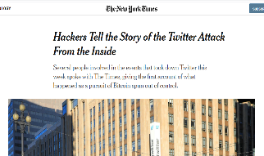
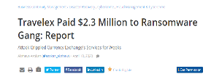
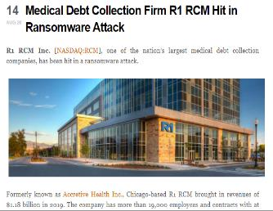
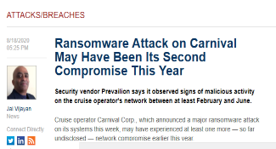
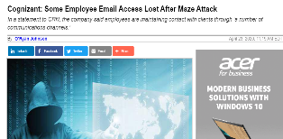
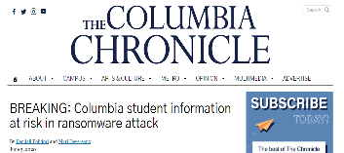
Randomware Attacks are Growing Exponentially Every Day

Slide 20
CPP Zero-Trust Security Fabric (ZTSF)
What is the CPP Zero-Trust Security Fabric?
Collection of industry leading solutions To form a blanket of protection around the entire infrastructure, transparent to operations
What does the CPP ZTSF Do?
Least privilege model of access using proven solutions
Leverage industry leading analytics that go beyond traditional signatures
Provide future-ready, visionary products that can protect on multiple fronts
Extend the border of the infrastructure to anywhere

Slide 21
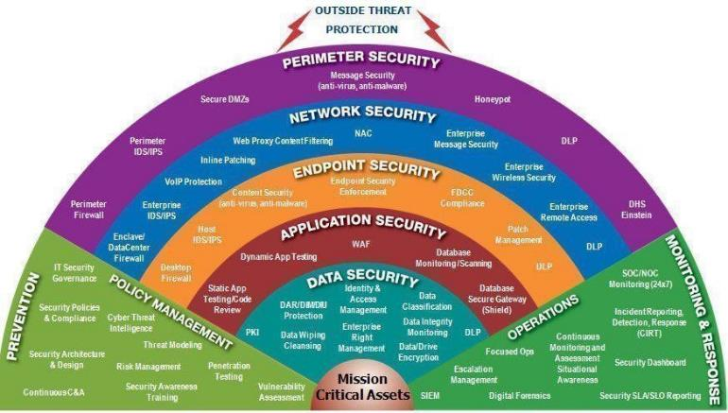
Note to designer: This graphic needs to be reimagined and redesigned; should build one layer at a time
CPP Zero-Trust Security Fabric (ZTSF)
Perimeter Security
Data Security
Message Security (Anti-virus, anti-malware)
Network Security
Identity & Access Management
Enterprise Right Management
DAR/DIMDIU Protection
Data Wiping Cleansing
PKI
Data Classification
Data Integrity Monitoring
Data/Drive Encryption
DLP
Endpoint Security
Application Security
Mission Critical Assets

Slide 22
Note to designer: This graphic needs to be reimagined and redesigned; should build one layer at a time
CPP Zero-Trust Security Fabric (ZTSF)
Perimeter Security
Application Security
Message Security (Anti-virus, anti-malware)
Network Security
WAF
Dynamic App Testing
Database Monitoring/Scanning
Static App Testing/Code Review
Database Secure Gateway (Shield)
Endpoint Security
Data Security
Mission Critical Assets

Slide 23
Note to designer: This graphic needs to be reimagined and redesigned; should build one layer at a time
CPP Zero-Trust Security Fabric (ZTSF)
Perimeter Security
Endpoint Security
End Point Security Enforcement
Content Security (anti-virus, anti-malware)
Host IDS/IPS
Desktop Firewall
FDCC Compliance
Patch Management
DLP
Message Security (Anti-virus, anti-malware)
Network Security
Application Security
Data Security
Mission Critical Assets

Slide 24
Note to designer: This graphic needs to be reimagined and redesigned; should build one layer at a time
CPP Zero-Trust Security Fabric (ZTSF)
Perimeter Security
Network Security
NAC
Webproxy Content Filtering
Inline Patching
VoIP Protection
Enterprise IDS/IPS
Enclave/DataCenter Firewall
Enterprise Message Security
Enterprise Remote Access
DLP
Message Security (Anti-virus, anti-malware)
Endpoint Security
Application Security
Data Security
Mission Critical Assets

Slide 25
Note to designer: This graphic needs to be reimagined and redesigned; should build one layer at a time
CPP Zero-Trust Security Fabric (ZTSF)
Perimeter Security
Perimeter Firewall
Perimeter IDS/IPS
Secure DMZs
Message Security (anti-virus,anti-malware)
Honeypot
DLP
DHS Einstein
Message Security (Anti-virus, anti-malware)
Network Security
Endpoint Security
Application Security
Data Security
Mission Critical Assets

Slide 26
Note to designer: This graphic needs to be reimagined and redesigned; should build one layer at a time
CPP Zero-Trust Security Fabric (ZTSF)
Outside Threat Protection
Perimeter Security
Message Security (Anti-virus, anti-malware)
Network Security
Endpoint Security
Application Security
Policy Management
Operations
Monitoring & Response
Prevention
Focused Ops
Escalation Management
SIEM
Digital Forensics
Incidental Reporting, Detection, Response (CIRT)
Continuous Monitoring & Assessment Situational Awareness
Security Dashboard
Security SLA/SLO Reporting
IT Security Governance
Security Policies & Compliance
Security Architecture & Design
Continuous C&A
Cyber Threat Intelligence
Threat Modeling
Risk Management
Security Awareness Training
Penetration Testing
Vulnerability Assessment
Data Security
Mission Critical Assets

Slide 27
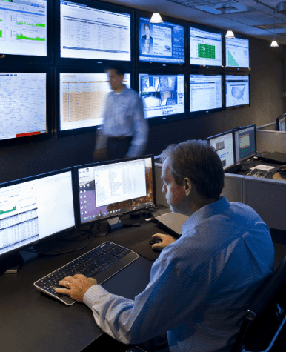
Security Operations Center (SOC) As A Service
SIEM Data Collector Health Checks
Fully Automated Notification System
Incidents reviewed to ensure proper categorization
Additional Checks for suspicious trends
Tier III IR Client Support for Notifications
Summary data reviews for “hidden” activities
Manual reviews of report to ensure accuracy
Reviews performed 7x365
Monthly Executive Summary Reports
Notes:
Security Operations Center
The SOC is able to provide monitoring in any environment and is especially useful when you do not have the internal staff to support the need.
This provides peace of mind, knowing that Data Collectors undergo regular health checks to ensure they are operating properly and sending data.
This allows for a fully automated notification system to ensure that alerts are received quickly when an incident occurs.
These incidents are reviewed to ensure proper categorization around priority and also to look for suspicious trends in the environment.
Also knowing that a Tier 3 Incident Response Engineer is available for support of notifications, ensures that you receive best in class support.
Summary reviews are conducted as well for look for hidden activity that may not have been identified in the normal alerting process as well and reports are reviewed manually by trained personnel to ensure accuracy 7 by 365.
And of course Monthly Executive Summary Reports to be reviewed as well to provide a insight into what is happening in the environment overall.

Slide 28
How to Get Started
Penetration Assessment
Simulated Gray-Box Attacks
Internal/External Scans
Service Enumeration/Fingerprinting
Exploitation
Technical Details of Identified Issues
High-Level Remediation Recommendations
Vulnerability Assessment
Internal/External Scanning
Identify Threat Avenues
Industry Leading Tools
CVSS Risk Registry Score
Technical Details of Identified Issues
High-Level Remediation Recommendations

Slide 29
Primary Solution Practices
IT Infrastructure/ Networking
Network Security
Data Intelligence
Managed Services

Slide 30
CPP Managed Services: InVision
Are you required to provide an extremely high level of IT services and security to your organization 24/7/365 days a year but don’t staff three shifts?
What if you could get most of your nights, evenings and weekends back and -- at the same time -- improved SLAs for the company , morale for employees and were able to do it at a lower cost?
CPP InVision Managed Services is the answer.

Slide 31
InVision Overview – What Is It?
End User Support
24 x 7 Service desk
Desktop Support
Application Support
Antivirus Software
Software Deployment Services
Datacenter Services
24 x 7 NOC
Physical Servers
Virtual Machines
Storage Area Networks
Backup & Disaster Recovery
Hybrid & Cloud Services
Network Services
24 x 7 NOC
Network Links
Routers & Switches
ISP Navigation
Wireless
Firewalls & VPN
Security
24 x 7 SOC
Firewalls & VPN
IDS/IPS
AAA & NAC
Mobility
SIEM

Slide 32
InVision – Assessment Driven
Assessment
Asset Discovery Tool
Security Discovery Tool
Network Discovery Tool
Review & Report
Outcome
Detailed Asset Inventory & Analysis
Environment Risk Analysis
Security Risk Analysis
Network Mapping
Risk Assessment Analysis & Review
Review Reports & Project Planning
Notes:
CPP also offers the InVision Assessment as well.
This is a broad scope report on the overall health, and security of an environment.
Using a specialized set of tools we can perform Asset, Security, and Network scans to discovery sometimes hidden issue within an environment.
These tools allow for a comprehensive detailed report showing:
Asset Inventory and Analysis
Levels of Risk within a given environment
Security Risks and vulnerabilities
Network Mapping
During this process we provide a detailed executive summary report containing our risk assessment and analysis along with recommendations around remediations of key issues that were identified.
Once reports are reviewed, we can also plan project services as well to help remediate issues in any area needed.

Slide 33
Conclusion
CPP Can Deliver What Customers Want and Need:
Next Steps
Agility/Elasticity
Automation
Availability
Self Service/Ease of Use
Performance
Security
Less Risk
Financial Models that Enable Revenue to Increase and/or Cost to Decrease
AI/Analytics
Intro Discussion with one of our Consultants
Scope IAA or other Service
Deeper Business Objectives discussion
Technology Mapping for Achievement
Partnership

Slide 34
Thank You!
Infrastructure. Anywhere
CPP Associates, Inc.
6 Route 173
Suite 203
Clinton, NJ 08809, USA www.cppassociates.com

