Slide 1

Medium’s Top Articles
2015
Top 100
Highlighted Passages

Slide 2

How I Crashed and Burned in YCombinator
“I don’t want to start another company until I find a problem that I care about. A problem that I eat, sleep and breathe. A problem worth solving.”
-@Charlie Guo
January

Slide 3

If I had to do it over,
I would skip the MBA
“It’s only in mid-life that we finally realize, there was no need to hurry.”
-@Anjali Gupta
January

Slide 4

I’ve Written 100 Posts on Medium, Here’s What I’ve Learned
“If you’re a passive member of the community, you get little out of it. You consume and move on. If you’re active, you get rewarded. It’s strangely like real life.”
-@Paul Cantor
January

Slide 5
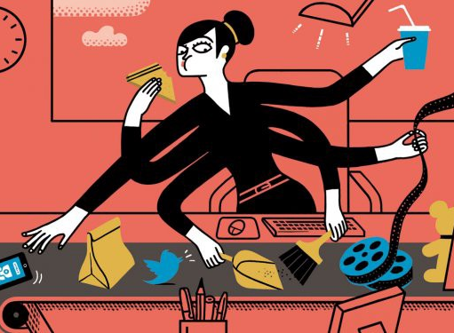
Age 40: Ain’t Nobody Got Time
For That
“I let other people be responsible for how they choose to respond to things.”
-@Amanda Clayman
January

Slide 6
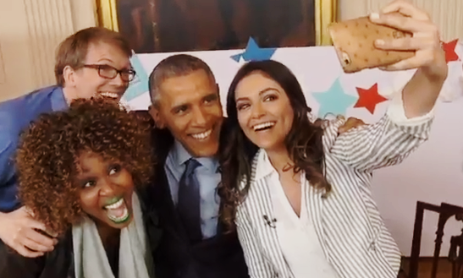
Holy Shit, I Interviewed the President
“Young people have absolutely no faith in people sitting at desks on television anymore.”
-@Hank Green
January

Slide 7
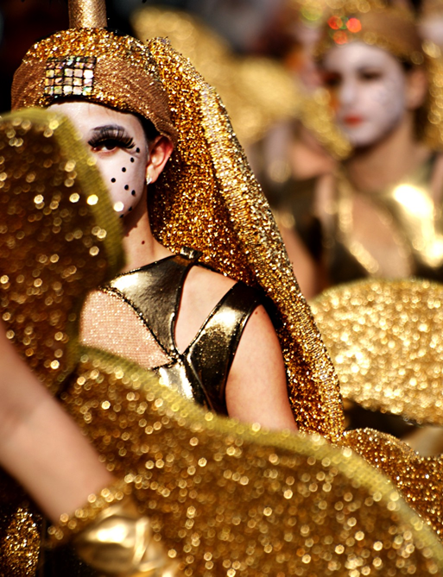
The Imposter Syndrome
“Asking is hard, but so is weathering a thousand little paper-cuts of interpretation.”
-@Julie Zhuo
January

Slide 8
The purge: What happens when you unfollow everyone on the Internet
“We’re among the first generations expected to maintain connections with every single person we’ve ever met, thanks to the Internet. The weight of our swollen social networks can be super stressful, let alone a distraction from knowing who you want to focus your.”
-@Helena Price
February

Slide 9

What China Gets Right About Relationships
“They tend to say less and do more, showing their care through considerate actions instead of words. The wall between strangers is higher, perhaps, but once you’ve crossed that wall, everything is shared.”
-@Sam Massie
February

Slide 10

Why I Just Fucking Did It
“Another thing I also noticed recently about the idea porn is that if I sleep on an idea, I will find it as a totally bullshit idea as soon as I wake up the next morning.”
-@Ali Mese
February

Slide 11
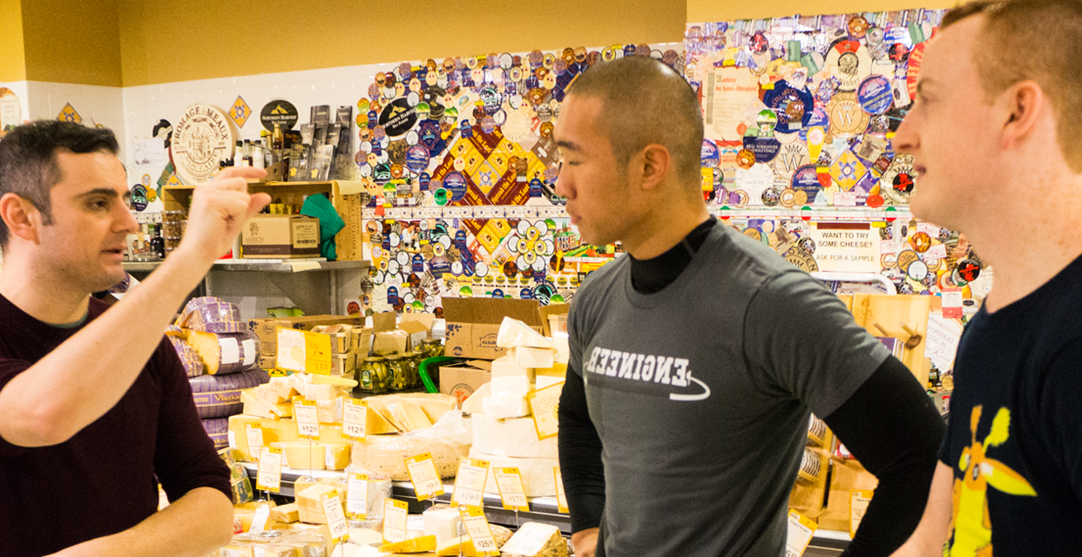
The Age of the Introvert Entrepreneur
“We are in the glory days of the introverted entrepreneur. Because of technology, there are so many ways to build a company now, talk to people and make connections in the business world; all without leaving your desk.”
--@Gary Vaynerchuk
February

Slide 12
Unicorns vs. Horses
“The siren call for many entrepreneurs isn’t money, it’s freedom.”
-@Andrew Wilkinson
February

Slide 13
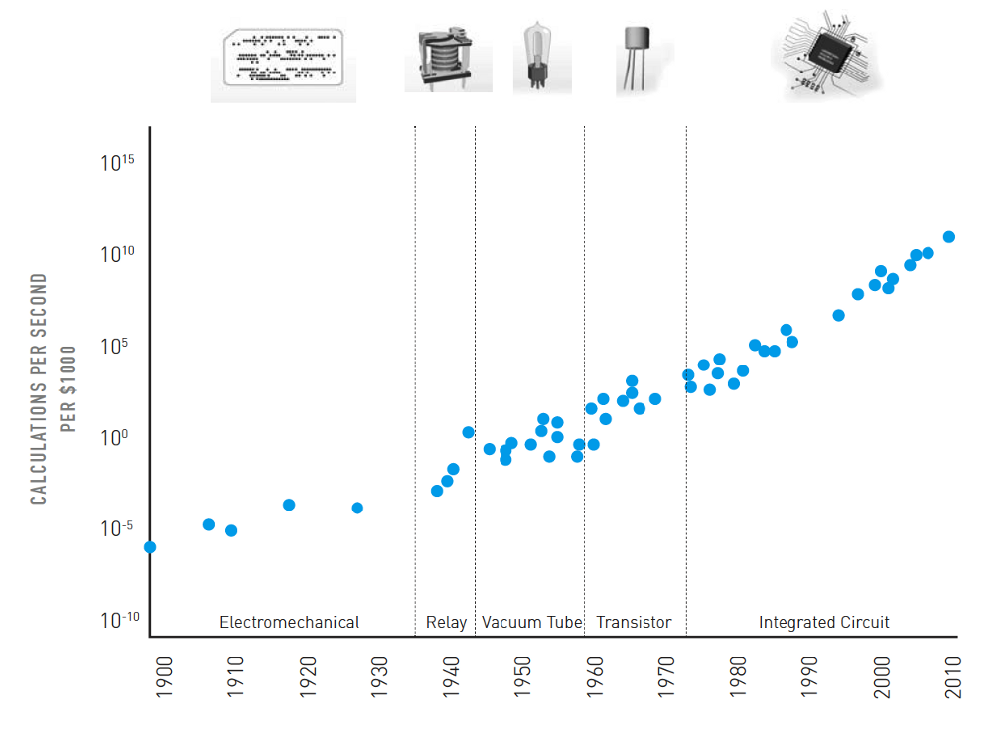
When Exponential Progress Becomes Reality
“Human perception is linear, technological progress is exponential.”
-@Niv Dror
February

Slide 14
Introducing Angels
“Technology is no longer an industry category.”
-@#Angels
March

Slide 15
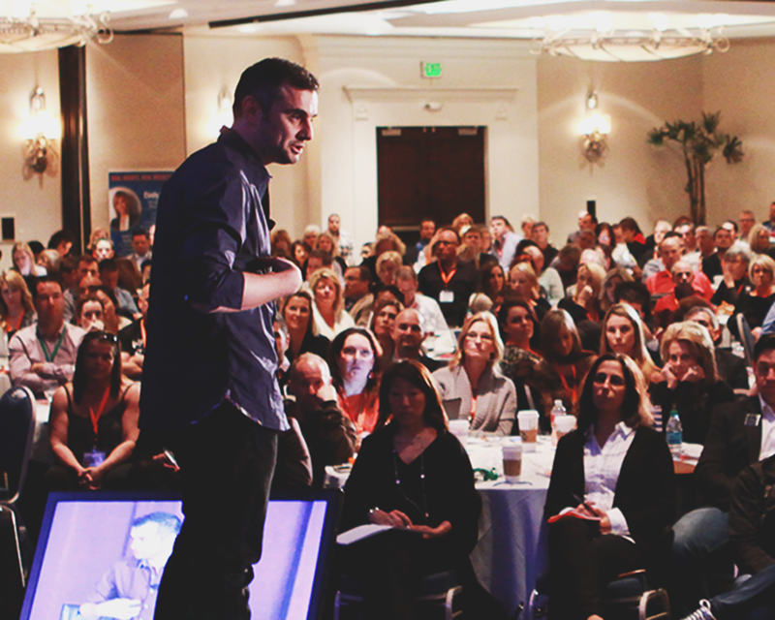
Being a People Pleaser is a Strength, Not a Weakness
“What is wrong with wanting to give? Being positive? Making sure everyone around you is happy? To me, these sound like the furthest things from a “weakness” and it blows my mind why people would want to label it as such.”
-@Gary Vaynerchuk
March

Slide 16
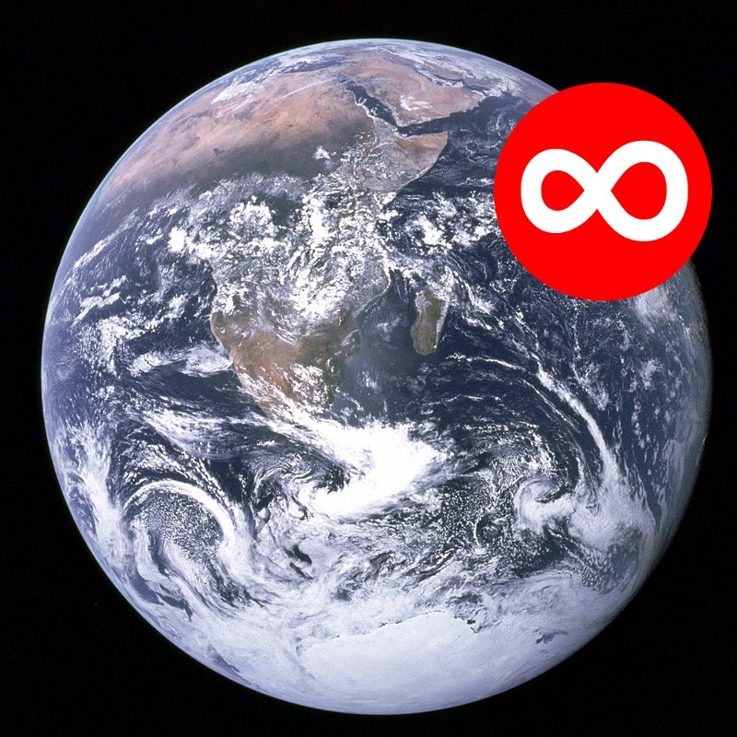
Notifications & Alerts
“I erased most of my TODO list since I really only need to stay alive and listen to people and everything else is a lie.”
-@Paul Ford
March

Slide 17
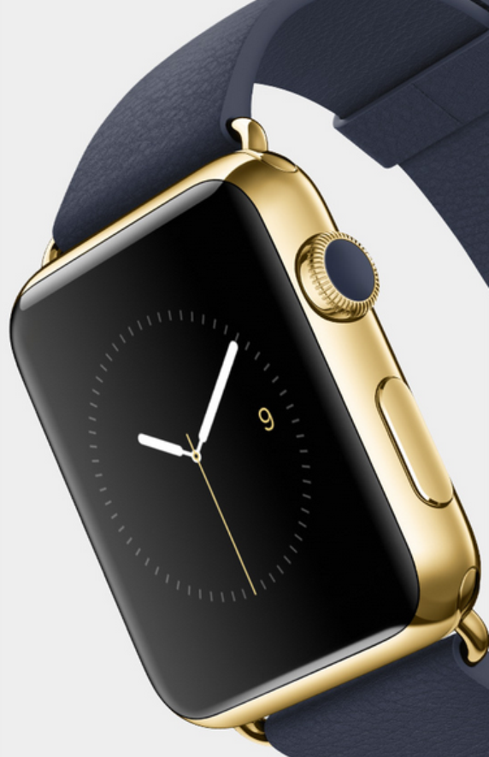
Apple’s Fork Into Fashion
“Not only is Apple not resting on their laurels, they’re pivoting the company in a pretty big way that’s flying under the radar to all but those watching most closely.”
-@M.G. Siegler
March

Slide 18

After GigaOm, The Non-VC “SimCity” Approach To Growing A Media Business
“Someone getting a lot of VC investment isn’t a sign they’re successful at anything other than getting VC funding.”
-@Danny Sullivan
March

Slide 19

The Joyless World of Data-Driven Startups
“I hypothesize that an early startup guided primarily by gut decisions from a strong strategic vision will be more cohesive and deliver a stronger offering than a startup created from a random walk of data-driven decisions.”
-@Dan Zambonini
March

Slide 20

Gigaom is dead. Long live Gigaom
“There’s a sort of barbell effect: If you are super small and super focused and super niche you can succeed, arguably. And if you’re super huge and mass and gigantic and growing quickly, you can succeed. But in the middle, is death. The valley of death. So arguably we .”
-@Mathew Ingram
March

Slide 21
You’re not doing the thing.
“Go do the thing.”
-@Chantal Jandard
March

Slide 22
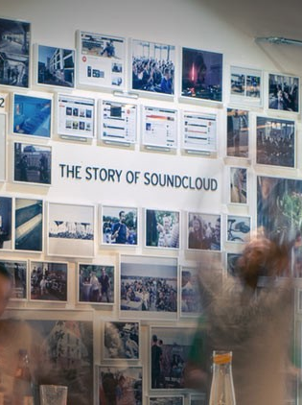
Six years at SoundCloud, Five Lessons Learned
“Culture is the sum of your people living the company’s core values day in and day out, amplified by how those values are communicated internally and externally.”
-@SoundCloud
March

Slide 23
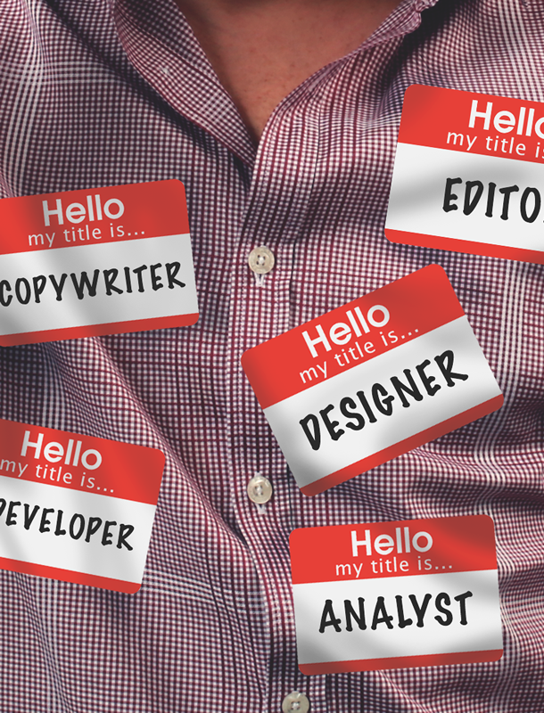
Specialist or Jack-of-All-Trades?
The Answer’s Obvious to Me
“I never think that you should focus on one particular skill. Never limit yourself to that.”
-@Gary Vaynerchuk
March

Slide 24
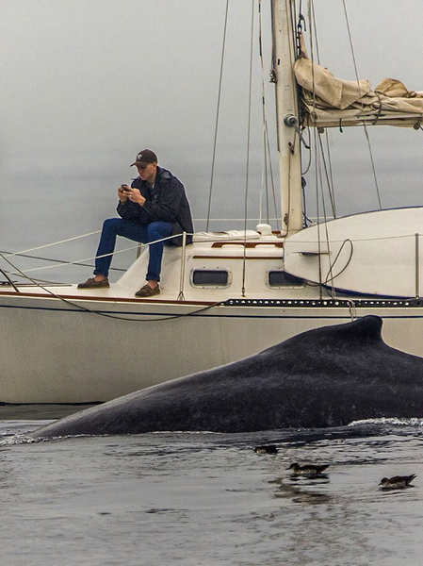
Going Viral
“It is amazing to have the world at your finger tips, but lets not miss the extraordinary world right in front of us.”
-@Vantage Staff
April

Slide 25

My Byline Is a Lie
“As I’ve grown older, I’ve come to embrace evolving narratives. Change doesn’t discredit past narratives, it just gives us room to grow and prevents us from standing still.”
-@Evelyn Rusli
April

Slide 26
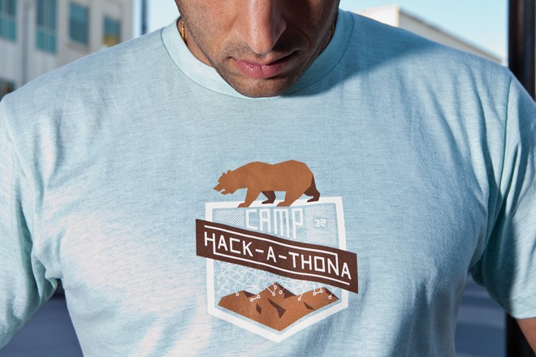
Hacking Company Culture
“Constraints are a remarkable force multiplier for innovation.”
-@Pedram Keyani
April

Slide 27

Thoughts from a woman who posts on the Internet
“Constraints are a remarkable force multiplier for innovation..”
-@Elizabeth Tobey
April

Slide 28

crazies.io
“Stop glorifying work hour martyrdom.”
-@Ash Huang
April

Slide 29
The One-Minute Test
“We find that it’s not unusual to discover that different people in the room had just attended completely different meetings..”
-@Jared M. Spool
April

Slide 30

You Hate Yourself Because
We Told You To
“You can be the absolute best in the world at the game that exists. Or you can make your own game.”
-@Nikki Lee
April

Slide 31


Bubble, My Ass: Some Unicorns Might Be Overvalued, But All Dinosaurs Gonna Die
“Unless they innovate more rapidly (or acquire their internet peers), expect most & 500 Dinosaurs to be disrupted and destroyed by an endless march of VC-funded Unicorns that will bash their tiny little reptile brains in with software and internet marketing.”
-@Dave McClure
April

Slide 32

How to Stop Checking Your Phone Like an Addict
“Usage and adoption of new technology nearly always outpaces our understanding of how that technology will ultimately affect us.”
-@Max Ogles
April

Slide 33

The Cult of Work You Never
Meant to Join.
“We wouldn’t go to work drunk, so why the hell do we go to work on four hours’ sleep, when we’re more impaired than if we were hammered?”
-@Jason Lengstorf
April

Slide 34
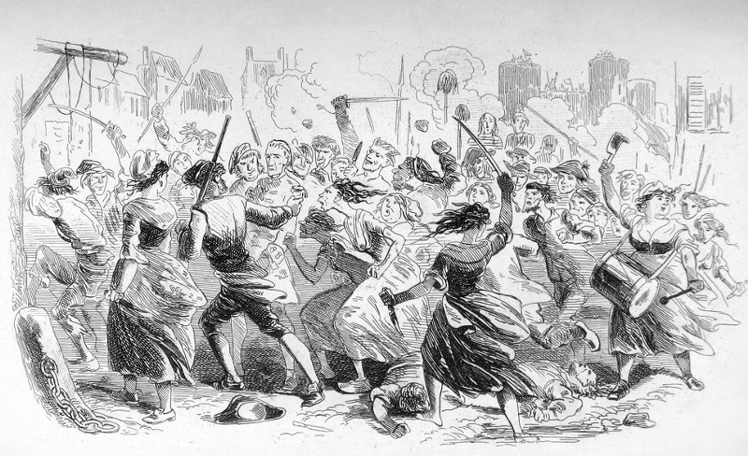
The state of storytelling in the internet age
“Buzzfeed is figuring out how to blend moneymaking fluff with compelling journalism, and they’re doing it all with a deep understanding of the internet and the way it operates.”
-@ReadThisThing
April

Slide 35
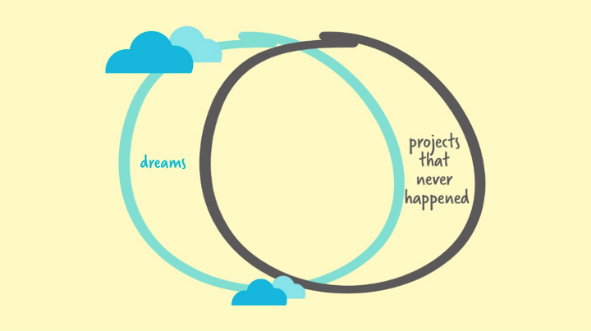
6 Ways To Destroy Your Dreams
“You have dreams? Be responsible for them. No one else will.”
-@Bel Pesce
April

Slide 36

How to Impress an Interviewer
“It matters less whether you have those skills today, as long as you’re clearly someone who will have those skills tomorrow.”
-@Julie Zhuo
April

Slide 37
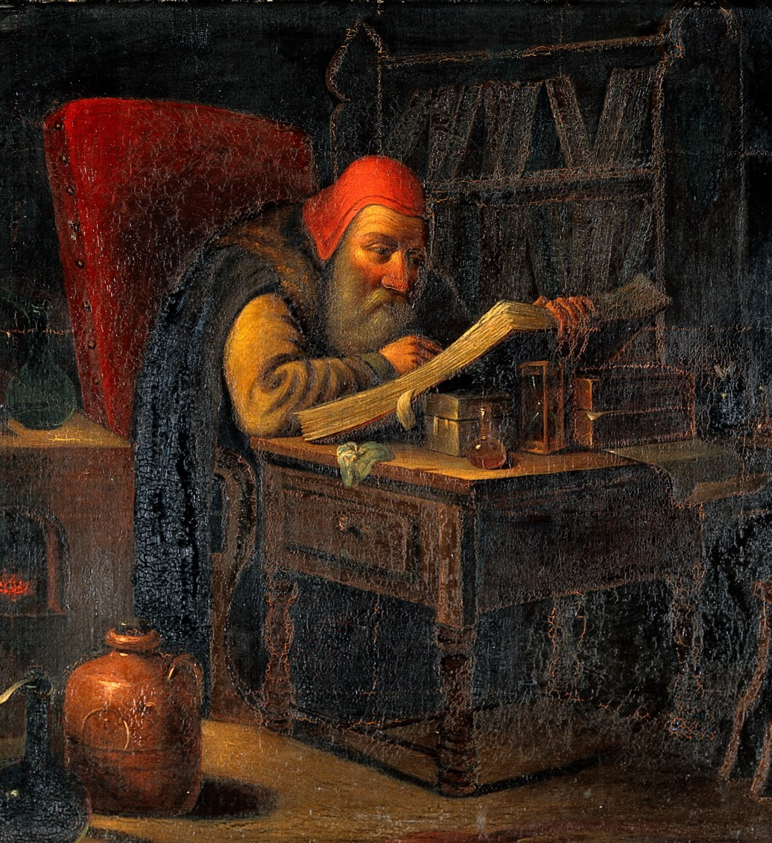
Why can’t we read anymore?
“Those who read own the world, and those who watch television lose it. (Werner Herzog)”
-@Hugh McGuire
April

Slide 38
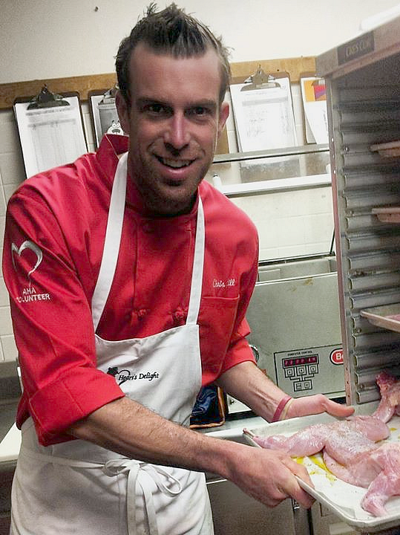
The Things I Wish I Knew Before Becoming a Chef
“Loyal employees are loyal, not because they have to be, but because they want to be. Chances are, you made them feel that way. Unfortunately, it’s just as true when it applies to unloyal employees.”
-@Chris Hill
April

Slide 39
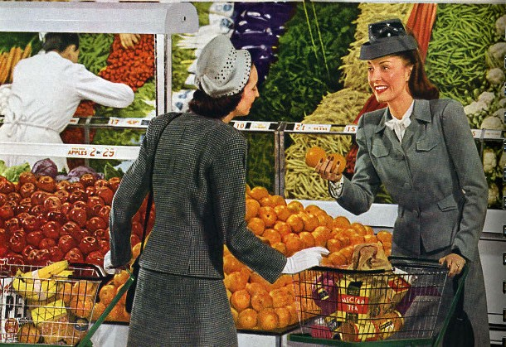
An Introvert’s Guide to Greeting Strangers, Vague Acquaintances, and Friends
“I am not a misanthrope. I am never mean to the people I meet. But experience tells me that, in most cases, I prefer my own thoughts to yours. Sorry. It’s nothing personal.”
-@Stuart Vyse
April

Slide 40

Nobody Famous
“But the truth is, our technological leaders have built these tools in a way that explicitly promotes the idea that one’s follower count is the score we keep, the metric that matters.”
-@Anil Dash
April

Slide 41

The Death of Awe in the Age of Awesome
“The world is full of magic things, patiently waiting for our senses to grow sharper.”
-@Henry Wismayer
April

Slide 42

The Best Advice Ever To A Teenage Daughter Who Needs To Make Money
“People think business is ‘Shark Tank’. Real business is more like ‘Tuna Tank’.”
-@James Altucher
April

Slide 43
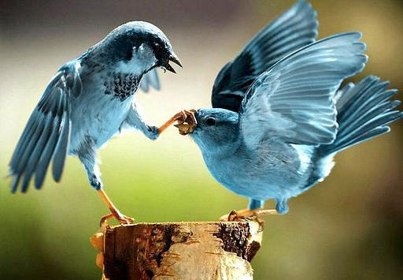
Twitter’s multi-billion dollar mistake happened five years ago
“The trouble for Twitter is that awareness of the service has long outstripped its usability.”
-@Mathew Ingram
April

Slide 44
Slack’s $2.8 Billion Dollar Secret Sauce
“Like a well-built home, great software focuses on giving its users hundreds of small, satisfying interactions.”
-@Andrew Wilkinson
May

Slide 45
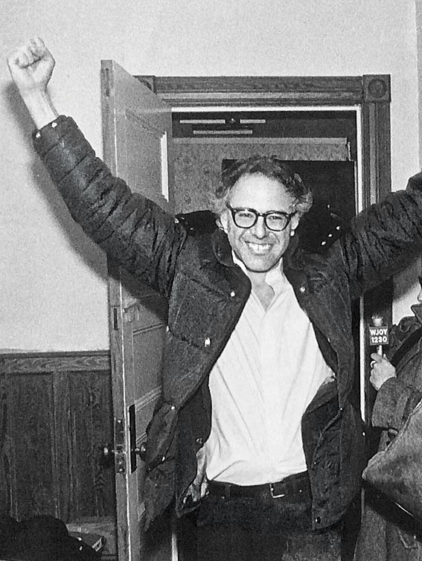
How to Talk to Your Kids About Bernie Sanders
“People born of privilege and connections float up a Rolex-studded ladder and then have to take classes in how to eat a hot dog in front of cameras like the lowly.”
-@Kimberly Harrington
May

Slide 46
Completely Truthful Answers to Lady Engineer Questions
“I appear young because I routinely bathe in the blood of my enemies.”
-@Adrienne Porter Felt
May

Slide 47

Things I Need to Come Up With a Better Way to Say to My Kids
“No one ever got into Harvard or Yale with only three tabs open. But it’s your life.”
-@Dave Pell
May

Slide 48

Why I Will Always Love My Ex-Boyfriends
“After all, it’s the stories that we tell ourselves that shape our past.”
-@Clarissa Wei
May

Slide 49

No One’s Gonna Remember You
“Treat the janitor like the CEO.”
-@Esquire Classics
May

Slide 50

The Future of Design in Technology
“At least half the tech products people use will be because of style and how it makes them feel rather than pure utility.”
-@Julie Zhuo
May

Slide 51
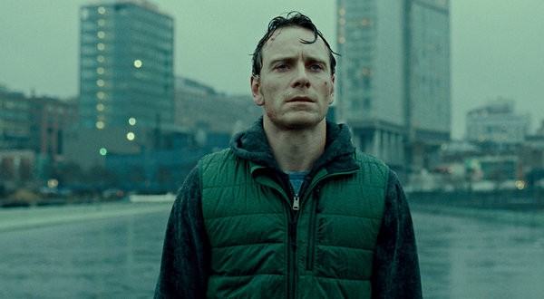
Social Shaming
“Making mistakes is the most important part of growth.”
-@Marc V. Calderaro
May

Slide 52
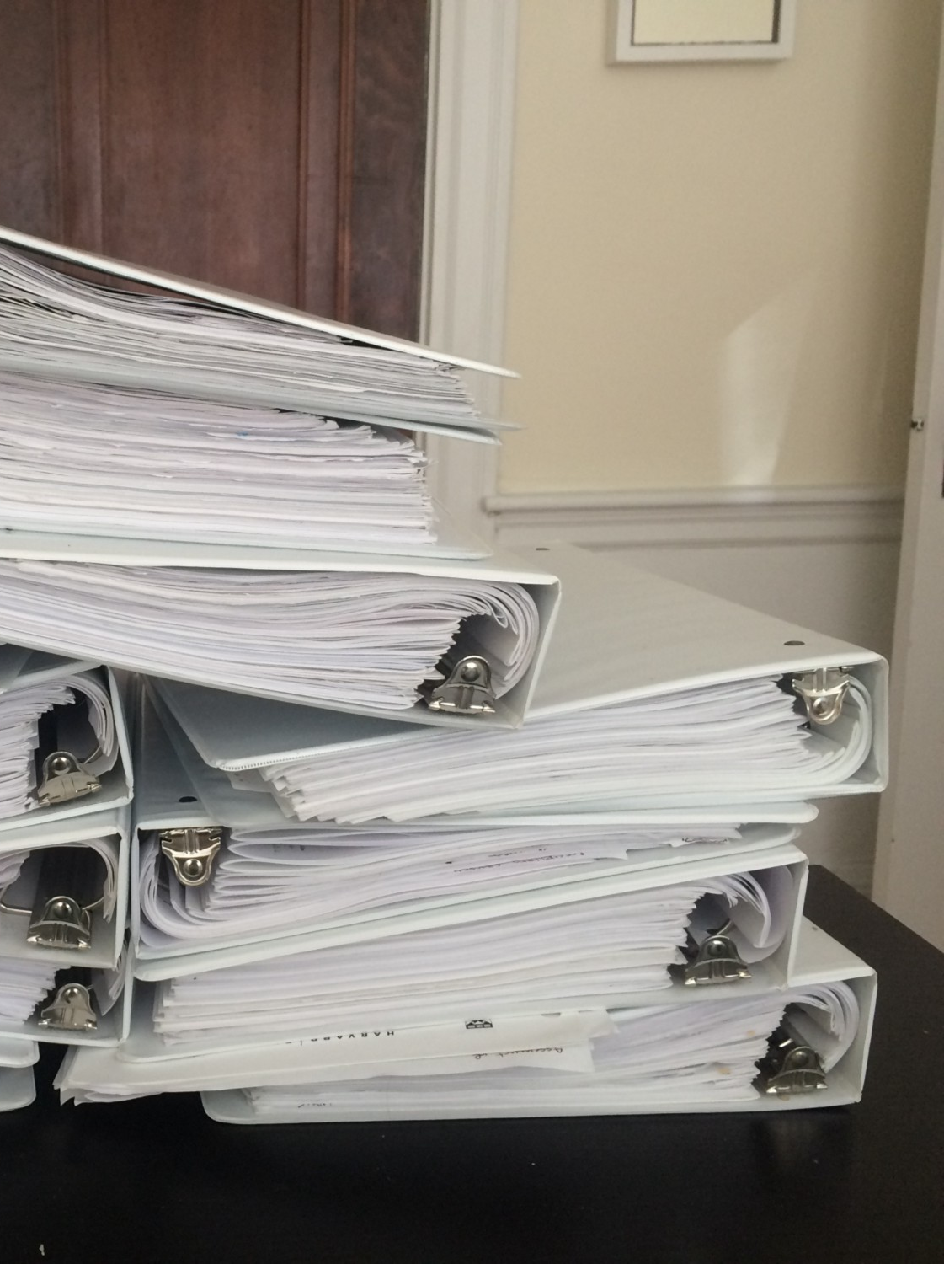
“What’s one thing you’ve learned at Harvard Business School that blew your mind?”
“When an employee has more accountability than control, this is considered an “entrepreneurial gap.” It’s typically created via an incentive system that encourages the employee to go beyond their span of control.”
-@Ellen Chisa
May

Slide 53

I Let IBM’s Robot Chef Tell Me
What to Cook for a Week
“You may need to make a ‘do I want to put mashed potato on this lasagne?’
leap of faith.”
-@Matt O'Leary
May

Slide 54

This Journey called Life
“Stop worrying about what people think of you. They’re probably not. They’re probably thinking about themselves. Or maybe what you think of them. Silly.”
-@Walter Punsapy
May

Slide 55

The Naked People In Your iPod
“Don’t confuse shame and guilt. Guilt is healthy?—?it says ‘Something I did is not ok.’ Shame is destructive?—?it says ‘I am not ok.’”
-@Paul Malan
June

Slide 56

Frankly Speaking: How I Found Purpose
“If you don’t design your own life plan, chances are you’ll fall into someone else’s plan. And guess what they have planned for you? Not much.”
-@Francesco Marconi
June

Slide 57
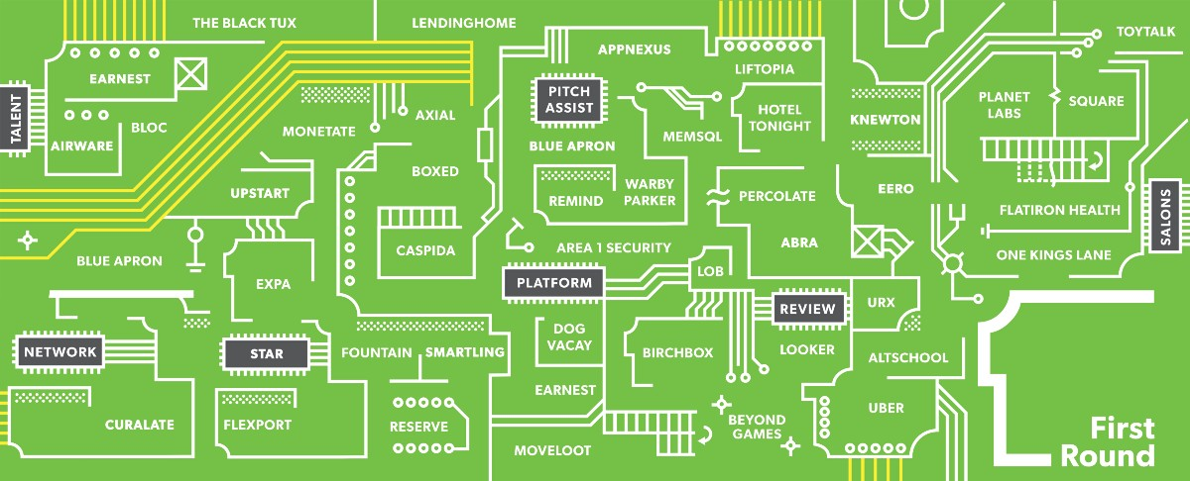
Startup Advising Is Broken
“A vast majority of startups have 5 to 10 general advisors who take equity and end up as nothing more than names on a slide deck.”
-@First Round
June

Slide 58
I’m a female scientist, and I agree with Tim Hunt
“Another time I dated a coworker for three months before realizing he was actually just an extra large lab coat with a smiley face drawn on the lapel.”
-@Allie Rubin
June

Slide 59

On Connecting…
“Your reputation is a function of how you treat people.”
-@Dustin Farivar
June

Slide 60

Creative Form & Input Field Design Examples
“So if you’re on a first date and you find out that your date starts picking their nose in the beginning of dinner, there will be no second date. But if you’ve been married to someone for years and they start digging for gold, you don’t immediately divorce them right.”
-@Saijo George
June

Slide 61

How A Slight Change In Mindset Accelerated My Learning Forever
“Timidity slows down the learning process.”
-@Tristan de Montebello
June

Slide 62

On Hanging Out, Cool Girls, and Being Clingy
“Lesson learned: Thou shalt not send three text messages in a row.”
-@Stella J
June

Slide 63
21 management things I learned
at Imgur
“You’re more likely to lose by not recognizing your weaknesses than from the presence of weakness, so aim for self-awareness.”
-@Sam Gerstenzang
June

Slide 64
Frankly Speaking: How I Learned to Be Heard
“In western culture, people have the tendency to fill up quiet space with unnecessary chatter. Resist that urge. Be patient, and when you have almost convinced someone your way is best, say little, or else you risk that person changing his or her mind. If a meeting is .”
-@Francesco Marconi
June

Slide 65

This is the Biggest Mistake a Young Entrepreneur Can Make
“To be a great business person, you can’t just be a peace-time general. You need to be a wartime general too.”
-@Gary Vaynerchuk
June

Slide 66

8 Things Every Person Should Do Before 8 A.M
“Indecision is a bad decision.”
-@Benjamin P. Hardy
June

Slide 67
How I Learned to Get a Lot Done Without Being Busy
“If it’s not a big, enthusiastic yes, make it a no.”
-@Isaac Morehouse
June

Slide 68
A black man walks into Silicon Valley and tries to get a job…
“This is how you develop a culture that isn’t diverse. You make it impossible for people who can’t afford to take a tryout across the country.”
-@Andy Newman
June

Slide 69

Why “Don’t Worry About Money, Just Travel” Is The Worst Advice Of All Time
“It’s aspirational porn, which serves the dual purpose of tantalizing the viewer with a life they cannot have, while making them feel like some sort of failure for not being able to have it.”
-@Chelsea Fagan
June

Slide 70

Everything Is Yours, Everything Is Not Yours
“The world owes you nothing; nobody deserves more or less than the next person.”
-@Clemantine Wamariya
June

Slide 71
We need to talk about startups…
“You only find out who is swimming naked when the tide goes out.”
-@Andrew Wilkinson
June

Slide 72

I built, launched, and got paying customers for my side project in 3 hours
“Being an entrepreneur is like staring into the abyss and chewing glass.”
-@Marc Eglon
July

Slide 73
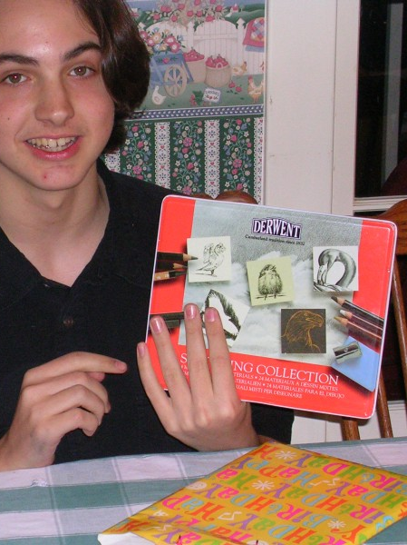
How I Became an Artist
“Because if you just keep going, eventually you’ll find yourself somewhere.”
-@Noah Bradley
July

Slide 74
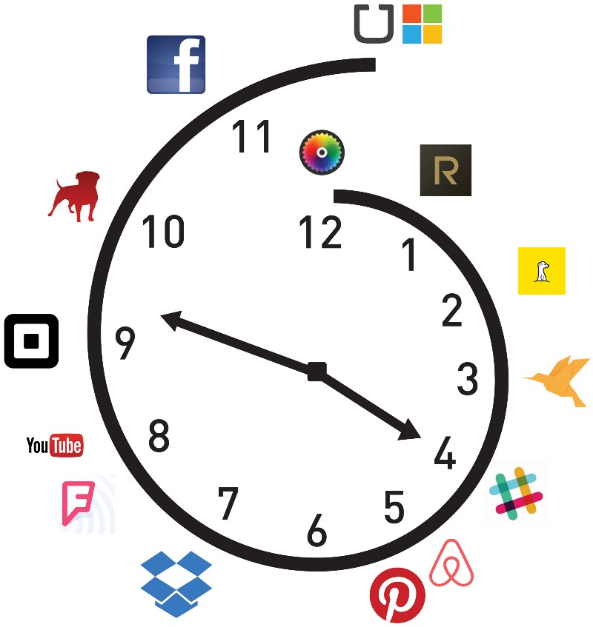
How the Tech Press Forces a Narrative on Companies it Covers
“You’re never as good as everyone tells you when you win, and you’re never as bad as they say when you lose?”
-@Aaron Zamost
July

Slide 75

What I Learned When I Gave Up
the ‘9 to 5’
“People buy things they don’t need with money they don’t have to impress people they don’t like.”
-@Jacob Laukaitis
July

Slide 76

Why You Should Do Your Work First, Others’ Work Second
“Best-selling author and researcher Tom Rath reinforces this point by saying, ‘What you will be most proud of a decade from now will not be anything that was a result of you simply responding.’”
-@Andrew Merle
July

Slide 77
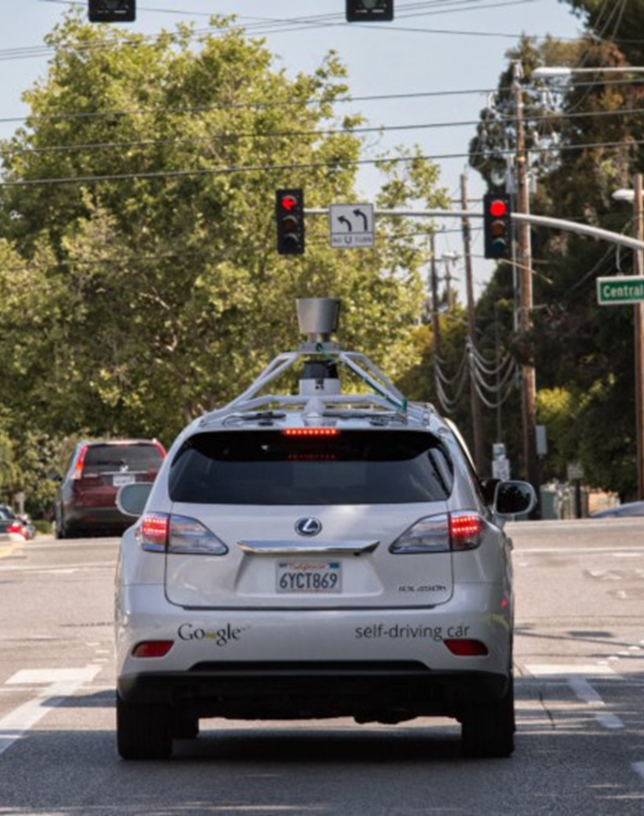
The View from the Front Seat of the Google Self-Driving Car, Chapter 2
“Our self-driving cars are being hit surprisingly often by other drivers who are distracted and not paying attention to the road.”
-@Chris Urmson
July

Slide 78

Why you need design
“An airline seat is purposely designed to fill you with regret and levels of sadness unknown in human history outside the Spanish Inquisition.”
-@Mike Monteiro
July

Slide 79

Paul Graham’s Startup Advice
for the Lazy
“The best way to come up with startup ideas is to ask yourself the question: what do you wish someone would make for you?”
-@Stelios Constantinides
July

Slide 80

Just Admit It, Part One
“You wouldn’t have noticed Neil Young was missing from your streaming service if he didn’t mention it.”
-@Dave Pell
July

Slide 81

Fairly Random Thoughts on Ashley Madison & the Swiftly Moving Line
“The whole infrastructure of web-service privacy is broken, as broken as the broken record that keeps saying ‘the whole infrastructure of web-service privacy is broken’ over and over again.”
-@Paul Ford
July

Slide 82

Uber’s Secret Weapon
“Burnout does nothing to move your startup forward and undoes your previous sacrifices.”
-@Danny Minutillo
August

Slide 83

How To Make Something People Give A Shit About
“It’s easy to mistake excitement for passion, motivation and ability.”
-@Jon Westenberg
July

Slide 84

If Your Coworkers Were Rappers
“There are many ways to deal with annoying coworkers, but obviously the most effective way is to picture them as rappers.”
-@Sarah Cooper
August

Slide 85
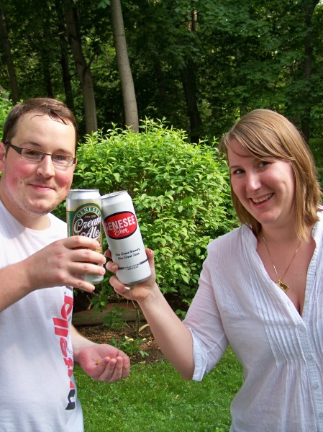
I’m Sorry I Didn’t Respond to Your Email, My Husband Coughed to Death Two Years Ago
“Being comfortable being uncomfortable is a very effective way to be a human.”
-@Rachel Ward
August

Slide 86

Streaming Music is Ripping You Off
“It’s like you bought a CD and the store told you that you had to listen to it 1,000 times, or they will give your money to Nickelback.”
-@Sharky Laguana
August

Slide 87

Work Hard, Live Well
“The research is clear: beyond ~40–50 hours per week, the marginal returns from additional work decrease rapidly and quickly become negative.”
-@Dustin Moskovitz
August

Slide 88

I Don’t Own, I Uber
“What I didn’t expect was that depending on Uber (UberX specifically) would actually be cheaper than owning and driving a car. Much cheaper.”
-@Megan Quinn
August

Slide 89

Emotional Intelligence in Design
“We don’t stop being human when we go online.”
-@Beth Dean
August

Slide 90
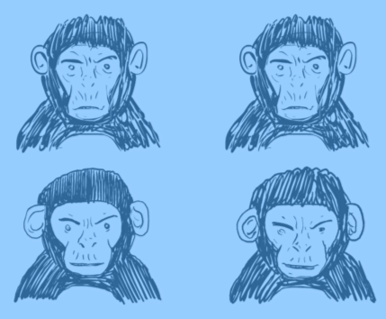
8 Reasons to Turn Down That Startup Job
“The world needs fixing, not disrupting.”
-@Mike Monteiro
August

Slide 91
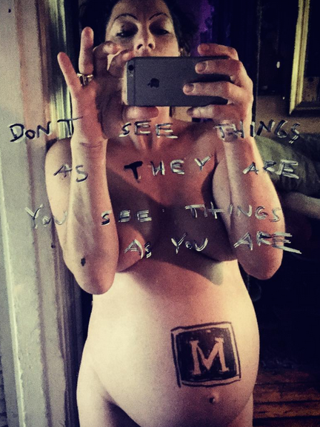
No, I Am Not Crowdfunding This Baby (an open letter to a
worried fan)
“We’re artists, not art factories.”
-@Amanda Palmer
August

Slide 92
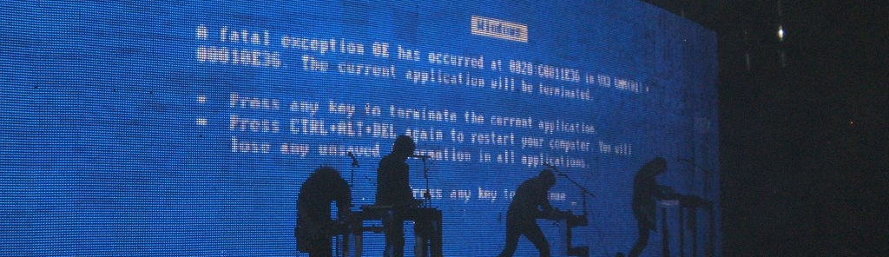
How to write a great error message
“The best error message is the one that never shows up”
-@Thomas Fuchs
August

Slide 93

Dear Mother
“For those of you reading: it’s okay to let go of your family. Society tells us that family is number one in your life?—?they come first. Civilisations and countries are built on the notion of the strength of the family unit. They would do anything for you, and you would.”
-@Katja Bak
September

Slide 94

28 Ideas for Becoming 5 Times More Productive Every Week
“Steve Jobs said that what made Apple Apple was not so much what they chose to build but all the projects they chose to ignore.”
-@Thomas Oppong
September

Slide 95
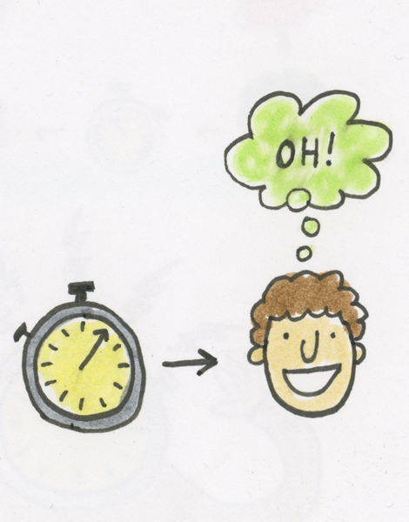
Give it five minutes
“There are two things in this world that take no skill: 1. Spending other people’s money and 2. Dismissing an idea.”
-@Jason Fried
September

Slide 96
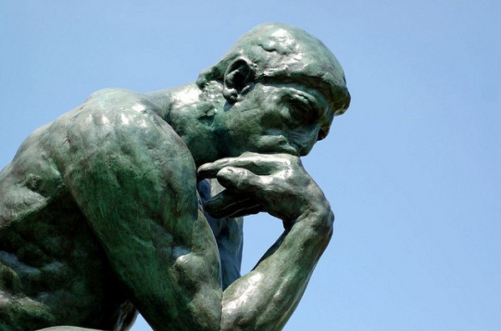
The Death of Thought
“I spend so much of my day having information pushed at me, yet I spend almost no time to actually process it.”
-@M.G. Siegler
September

Slide 97

The Art of Making Good Decisions
“The fact is, most decisions aren’t life-changers.”
-@Jeff Goins
September

Slide 98

31 Actionable Ideas from Ten Books I Wish I Had Read Ages Ago
“Rate the importance of a task by asking yourself, ‘If this is the only thing I do today, would I be happy with today?’”
-@Louis Tsai
September

Slide 99
Some advice from Jeff Bezos
“This doesn’t mean you shouldn’t have a well formed point of view, but it means you should consider your point of view as temporary.”
-@Jason Fried
September

Slide 100

How To Keep Loving Someone
“Love is being acutely aware of how quickly someone could ruin you.”
-@Jamie Varon
September

Slide 101

The Death of the Death of Books
“What if books, unlike various physical forms of music or movies, are the medium that weathers the digital onslaught?”
-@M.G. Siegler
September

Slide 102

Shift Your Mindset By Saying Less of These Four Things
“The best way to combat the unfairness of life is to find where life is unfair in your favor.”
-@ToddBrison
November

