Slide 1
COMPELLING LESSONS LEARNED, FROM:
“Hope Never Dies”
HOPE NEVER DIES
HOW 20
LATE-STAGE AND TERMINAL
CANCER PATIENTS
“BEAT THE ODDS”
By Rick Shapiro, B.A., J.D.,
Author and Cancer Coach
RickShapiro16@gmail.com
Copyright © 2018, Rick Shapiro, Innovative Healing Press, LLC, All Rights Reserved
Notes:
The origin, development and experience of creating my book, Hope Never Dies, has been a Life Changing, and Enlightening Experience for me: I have learned many lessons from the people I interviewed, not only about the Integrative and Alternative Protocols they implemented, but about what’s truly important in life. The many patients and cancer specialists have helped me understand much about: how to live life with intention, about priorities, about what’s important, how to face fear, how to take control, and, in the cancer world, to not allow ‘nonsense and false rhetoric”, sometimes disguised as a flawed therapeutic approach, to be your guidepost. I have learned that personal transformation of any kind is possible, and sometimes transformation is more likely when we are faced with real adversity. I could talk to you for many hours about the “lessons learned” from the cancer patients and cancer specialists, I interviewed. My intent during this presentation is to inform you about things I have learned, collectively, from the remarkable patients and cancer specialists. (PAUSE) … Specifically: If you are dealing with a Cancer diagnosis, always remember: YOU ARE NOT A STATISTIC, YOU ARE AN INDIVIDUAL, AND THERE ARE MANY-MANY PEOPLE WHO HAVE BEATEN THE ODDS. PEOPLE WHO HAVE BEEN TOLD THEY ARE TERMINAL, AND WHO ARE THRIVING MANY-MANY YEARS LATER. I HAVE PERSONALLY MET HUNDREDS OF THESE PEOPLE, ACROSS THE COUNTRY. AND, I AM HERE TO TELL YOU: THERE IS REAL HOPE …

Slide 2
BACKGROUND INFORMATION
No Disclosures or Conflicts;
No Monetary Exchange with Interviewees
Board Member: Annie Appleseed Project
Member: Society of Integrative Oncologists
Member: Oncology Association of Naturopathic Physicians
Rick Shapiro: Former practicing Attorney, “not” an M.D., N.D., Ph.D; Financial Advisor: “The Wheatley Group”, a Merger & Acquisition Firm
My Passion: Counsel, Inspire, Empower & Educate People about Safe, Evidence-Based Integrative/Alternative Cancer Therapies To Save Lives.

Slide 3
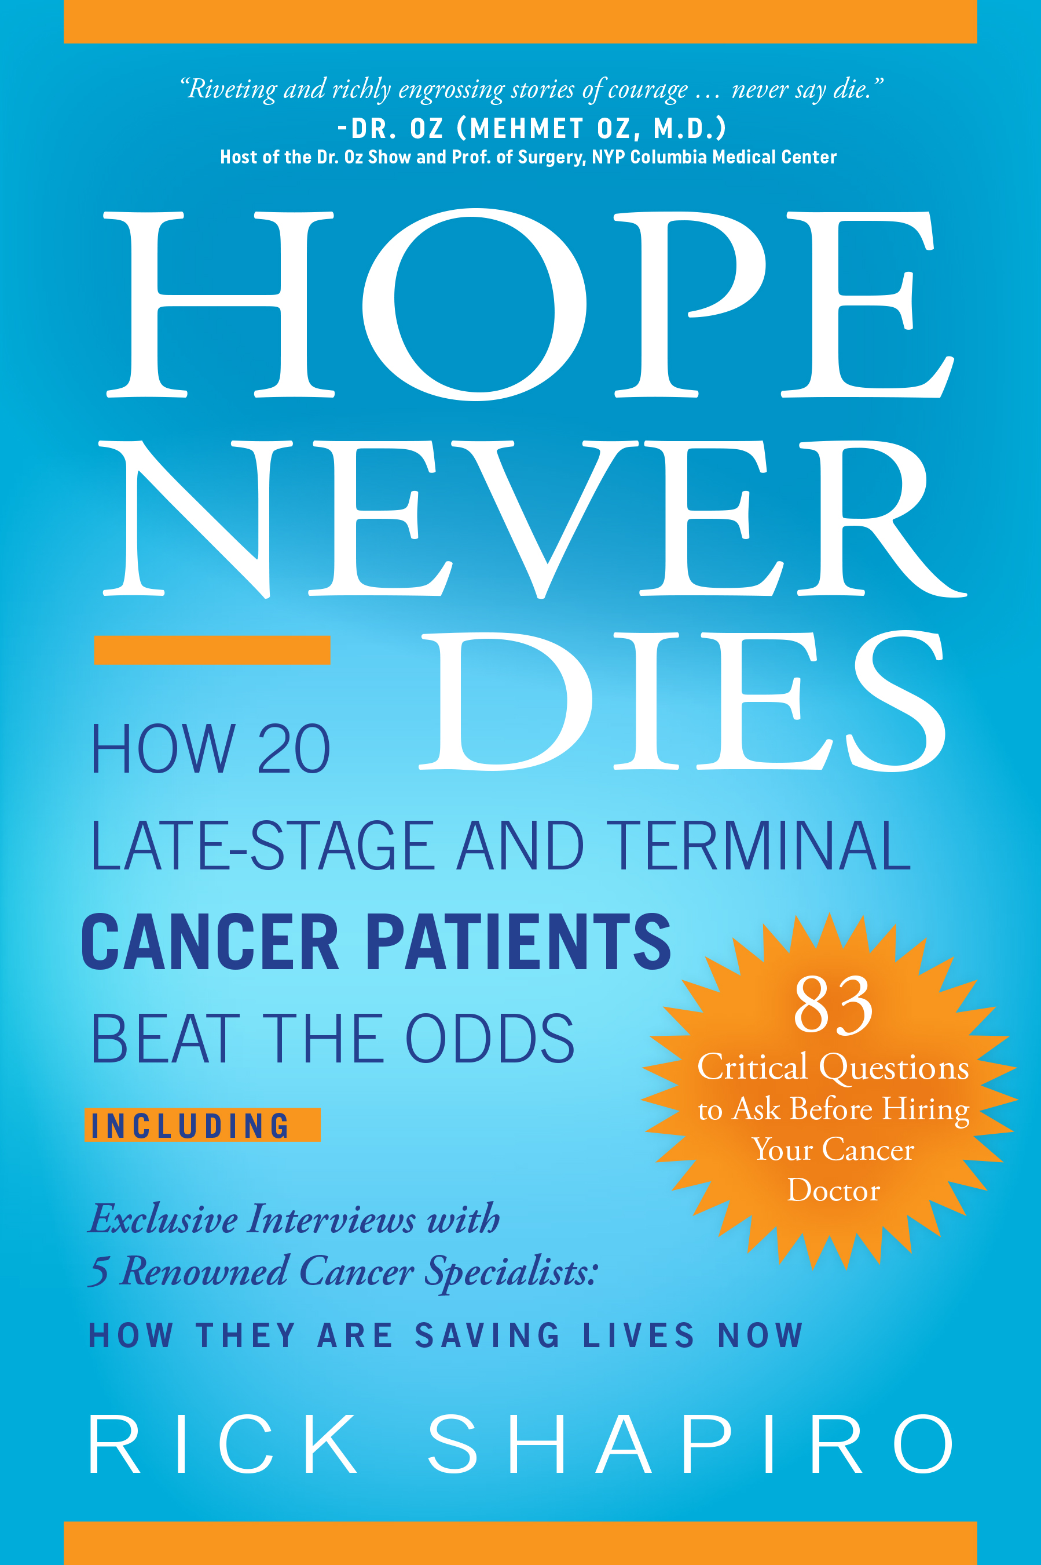
“Riveting and richly engrossing stories of courage... never say die.”
Dr. Oz (Mehmet Oz, M.D.)
Host of the Dr. Oz Show and Prof. of Surgery,
NYP Columbia Medical Center
“The title says it all. There is no false hope and statistics do not foretell the future. We all have the potential for self-induced healing. there is much to be learned from those who don’t die when they are supposed to and both doctors and patients need to be aware of the lessons to be learned”
Bernie Siegel, M.D.
Author of Love, Medicine and Miracles and
the Art of Healing

Slide 4
“In his outstanding book, Hope Never Dies, Rick Shapiro offers us a window into the lives of extraordinary patients and the paths they have taken to defy the odds of the ‘experts’. He provides an inspiration not only for patients and their families, but a critical message for the conventional oncology community to awaken to the value of a true integrative approach…”
D. Barry Boyd, M.D., M.S.
Assistant Professor of Medicine,
Yale School of Medicine
Director of Cancer Nutrition,
Yale New Haven Health
Senior Attending Medical Oncology,
Greenwich Hospital

Slide 5

HOPE NEVER DIES: Trailer

Slide 6
HISTORY: Why …“Hope Never Dies”
My Dad: Aggressive Lymphoma
January 15, 1996: M.D., “We will bring out the Big Guns …” (Highly Potent Chemotherapy)
Horrific Side Effects, Almost Death: Dad said: “No more.”
February 15, 1996: M.D.: “We look at your Dad’s situation as terminal.” Helpless—Hopeless.
March 29, 1996: My father dies of cancer; Tough—Difficult time ...
My Personal Scare
2001: Cimbing Liver Enzymes; Scans/Tests: M.D.“ ... Biopsy on your Liver.”
“Make a Deal”: One month... Transformed Diet = Normal Liver Enzymes...

Slide 7
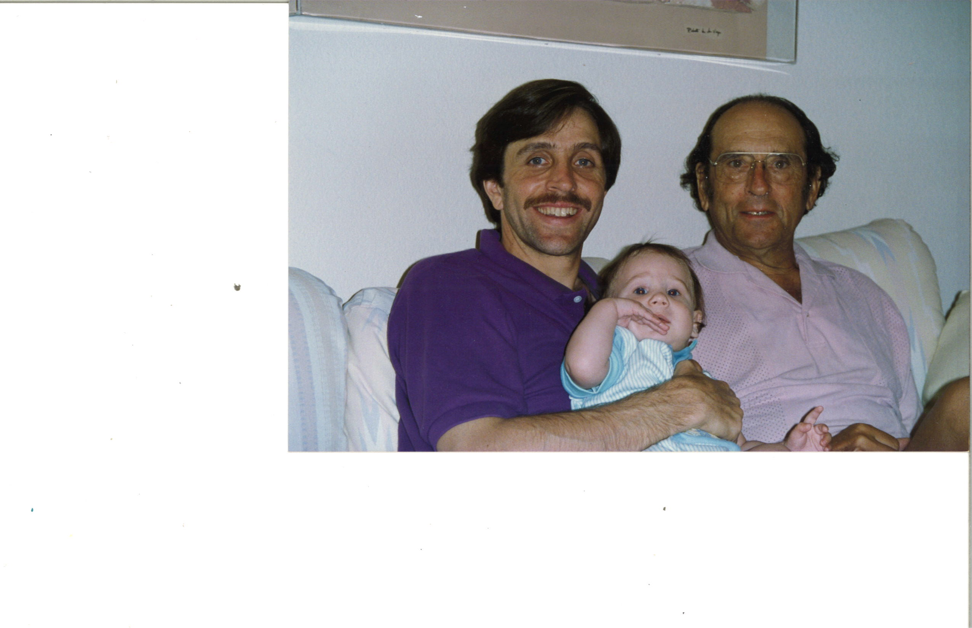
Dad, My Son and Me: 1992

Slide 8
Research: “Is there a better way than solely ‘SOC’ (chemo, radiation, surgery)?”
PubMed.gov
27+ Million Studies, Investigated Numerous Studies
Dan Schectman, Ph.D.
‘82, “Ridiculed, Fool”; 2011 Nobel Prize Chemistry
2010, Annie Appleseed Project
24 Conferences, and Mexican Clinics
Objective, Rational Analysis
WHY Do Some People “Beat the Odds?”
Notes:
IS THERE A BETTER WAY, BESIDES “STANDARD OF CARE?” IS THERE EVIDENCE THAT NON-STANDARD OF CARE CAN WORK, AND BE SAFE? NEED TO RECONSIDER THE BEST THERAPEUTIC APPROACHES …

Slide 9
Conclusions & Action…
Write “Hope Never Dies” …
Unequivocal Conclusion From Hope Never Dies:
There are Better Models Than Solely the “Standard of Care.” We Need to Formulate a Better Paradigm ...
People Need to Know
I have met hundreds of people who were told to get their affairs in order. Regardless, many are surviving and thriving many years later. People need to hear the stories, and learn about their transformational, life-saving treatments.

Slide 10
“Hope Never Dies”: Three Parts
Part One 20 Stores
13 Women; 7 Men... Breast, Colon, Lung, Prostate, Brain, Pancreatic, Ovarian, Kidney, Uterine, Melanoma, Bladder, Ureters, Others; Patients Tell Their Raw—Compelling, Inspirational Stories... Opinions, Recommendations; Providing Pearls of Wisdom...
Part Two
Deeply Instructive Interviews with 5 Renowned Cancer Specialists: How They are Saving Lives Now; K. Block, M.D., J. Wallace, Ph.D., R. Nagourney, M.D., Donnie Yance, D. McKee, M.D.
Part Three
83 Critical Questions to Ask Before Hiring Your Cancer Doctor

Slide 11
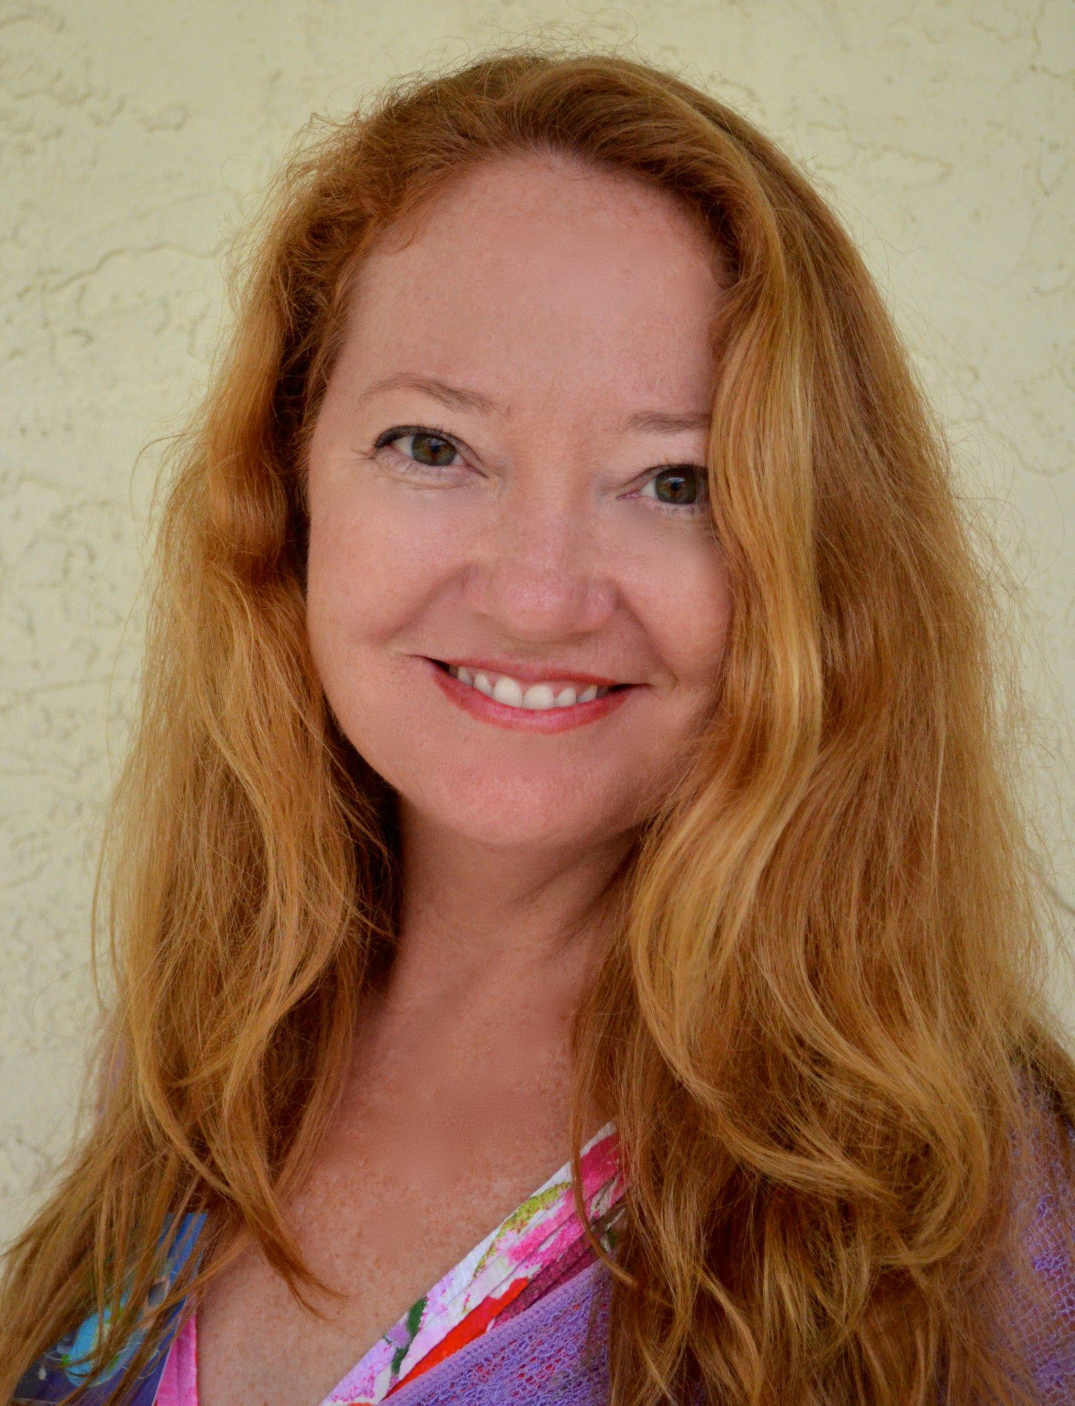
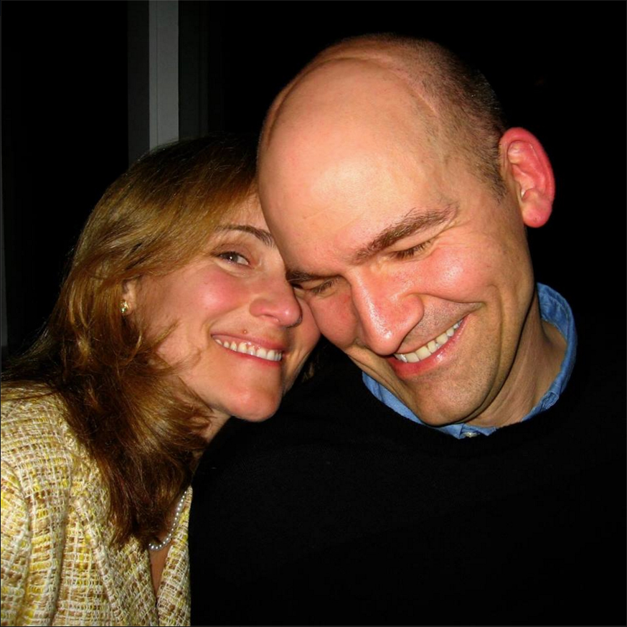
Julia Zahniser
Original Diagnosis: 2008
NNN Breast Cancer
3-4 months to live
Mark Olsztyn
Original Diagnosis: 1991
Glio - Brain Cancer
Dire Prognosis
Janet Sommer
Original Diagnosis: 1995
Lung, pancreas, liver, stomach
3-6 weeks to live; Hospice

Slide 12
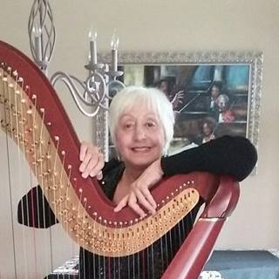
Barb Pytlewski
Original Diagnosis: 1988
Utne, Col, Ureters, mets
2 years to live
John Strauss
Original Diagnosis: 1991
Melanoma, lymph
Dire Prognosis
Annie Brandt
Original Diagnosis: 2001
Breast Cancer, lesions to lungs and brain.
3-6 months to live

Slide 13
Diane Klenke
Original Diagnosis: 2004
PancCa, liver
3 months to live
Joshua Pock
Original Diagnosis: 2005
Brain cancer
18 months to live
Elizabeth Panke
Original Diagnosis: 1999
Ovarian, uterine, stomach
2 months to live

Slide 14
LESSONS LEARNED
“You are not a Statistic”

Slide 15
LESSONS LEARNED
“You are not a Statistic”
“There are lies, damned lies and statistics”
Attributed to Benjamin Disraeli, British Prime Minister
Everyone is Different
Bio-chemistry, habits, health history…
“You are an Individual.” Again - You are not a Statistic.
Everyone responds to “dire pronouncements” differently
Many recede into depression and accept purported “expiration dates”; others seek out other non-standard of care medical options. Most people are not proactive about finding “out-of-the-box” therapies, beyond the standard-of-care.

Slide 16
LESSONS LEARNED: Attitude Matters

Slide 17
LESSONS LEARNED: Attitude Matters
Uniformly Prevalent
After initial shock, fear, anxiety and high stress...
Fighting Spirit
Goals, Purpose, Future Events...
No-Quit Attitude
Not Accepting Dire Predictions...
Knowing There is HOPE
The success stories of others is Critical...

Slide 18
LESSONS LEARNED: Seeking and Implementing Other Evidence-Based Treatments and Therapies
“Other”, Non Standard-of-Care Therapies and Treatments, implemented and administered “with and/or without” standard of care, CAN BE Profoundly Influential.
The Great Majority of Patients implemented several approaches, simultaneously, “not” one-off, singular, “silver-bullet” approaches.

Slide 19
LESSON LEARNED
Multi-Faceted Therapeutic Approach
Multi-Faceted, Comprehensive, Systemic…
Delivered by Sophisticated Doctors/Healthcare Practitioners…
Personalized to the Individual (Non-generic approach)…
Based on Objective Assays, Tests and Criteria…
Administered with “Compassion”…
Many Conventional Doctors: “Blindspot” or “Dismissive/Skeptical Attitude” re: the Value and Benefit of “True, Comprehensive Integrative Cancer Care”

Slide 20
LESSONS LEARNED
What Constitutes Evidence?
The Conventional “Gold Standard”
Mainstream Medicine’s Sacred Cow - FDA, Phase 3, Large-Randomized, Double-Blind, Placebo Controlled Study; 10-15 years.
Tufts University
$2.5 Billion (2014-Study of Drug Approval).
Long-Term Patents
Protect Financial Investment & Reap Billions (TV Ads, Ubiquitous)
Natural Agents (non-pharmaceuticals)
Cannot procure patents, no one will incur the huge expense without a potential ROI.
Other Relevant Evidence
Epidemiological Studies, Case Studies, Case Reports, Clinical Studies … Strong correlations of benefit exist ... We cannot ignore patient results!

Slide 21
LESSONS LEARNED
Which Therapies Implemented?
Mind-Body Therapy
Nutritional Oncological Strategies
Evidence-Based Supplementation Programs
Exercise Regimens
Non-Generic Chemotherapy

Slide 22
LESSONS LEARNED
Mind-Body Therapies

Slide 23
LESSONS LEARNED
Mind-Body Therapies
The Conventional “Gold Standard”
Stress, Fear, Anxiety and Depression: Weakens immune system. Example: Placebo lost hair case (Radical Remission...)
Importance—Immune Systems
Need strong, vital NK cells, T-Cells, B-Cells, Macrophages, other aspects, to DETECT and FIGHT Cancer.
Potential Mind-Body Therapies
Meditation, Prayer, Humor, Music, Other Stress Relaxation Classes and Techniques Can be Impactful.

Slide 24
LESSONS LEARNED
Mind-Body Therapies
“One example concerns an 11-year study of a stress management technique known as “progressive muscle relaxation” with breast cancer patients, at high risk of relapse, at the James Cancer Center of Ohio State University. The study found that regular practice of this technique reduced the risk of dying of breast cancer by 56 percent. There is no reason to expect that these benefits would be confined to a single cancer type.”
Dwight McKee, M.D.
“I have also learned that patients who are motivated by something unfinished in their life, like raising a child, or those with a goal to achieve an unfinished work, do much better than those who are motivated primarily by fear of dying. Unfortunately, many people involved in treatments are motivated by the fear of dying versus a drive to accomplish specific things.”
Dwight McKee, M.D.

Slide 25
LESSONS LEARNED
Mind-Body Therapies
“A cancer diagnosis is one of those times when we find ourselves unexpectedly tossed from the vessel and immersed in the turbulent waters. We can choose to struggle and exhaust our resources, or we can choose to let go, relax, breathe calmly and deeply, and simply allow the waters to support and carry us. Don’t let cancer take over your entire life. A wise woman with invasive bladder cancer—my mom—shared with our Facebook community her unique strategy for effectively managing the stress:
  “I am only going to have cancer before noon. It is too exhausting to be a cancer patient all day. Therefore, all cancer business must be accomplished before noon, and will have to be squeezed in before of after my hike.”
  Jeanne Wallace, Ph.D.

Slide 26
LESSONS LEARNED
Nutritional Strategies
Which Dietary Plan
Paleo, Vegetarian, Vegan, Macrobiotic, Gerson, Budwig, Ketogenic, Others …
NONE OF THE ABOVE... Individualize...
Jeanne Wallace, Ph.D.
Tailoring a protocol to the unique needs and biochemistry of the individual is the foundation of our approach. But we also take into account numerous considerations relevant to the type & stage of cancer.
HOWEVER... Commonsense
Eliminate/Mitigate – refined, processed, packaged foods (foods made in a plant); preserved meats and fish with nitrates, excess sugar/sugar equivalents; GMOs and artificial ingredients, foods with pesticides, herbicides, insecticides; soda pop, alcohol, refined vegetable oils, hydrogenated and trans fats, simple carbohydrates, SAD.
Eliminate or Mitigate
Animal protein, factory raised—institutional setting. The chemicals, anti-biotics, hormones and manmade food that becomes part of animals, ultimately is ingested by you, and becomes you.

Slide 27
LESSONS LEARNED
Nutritional Strategies
BUT - Commonsense: Include
Organically grown “whole foods”, e.g., berries, spices, seeds, leafy greens, vegetables, including cruciferous vegetables like: broccoli, cabbage, cauliflower, kale, collards, Brussel sprouts, radish’s, etc., and carotenoid-rich fruits and vegetables known for their deep orange, red and yellow hues. Essentially: Consume, largely, a plant-based diet with phytonutrients.
Animal Protein
Keep it to smaller quantities – grass/pasture fed, wild fish (not farmed), poultry not fed with man-made chemicals.

Slide 28
LESSONS LEARNED
Nutritional Strategies
Analyzing bloodwork closely, to ascertain what ”nutritional” changes are important, to optimize better outcomes, renders “personalized” results.
Jeanne Wallace, Ph.D. points out:
“We’ve searched the published research to identify cut-off points on specific lab tests that are associated with optimal wellness, better prognosis, longer survival, or a reduced risk of cancer recurrence. The optimal target range helps define the specific environment within the body that is less hospitable to cancer growth and progression.”
“Our guidance is always personalized. For example, many cancers—not just Estrogen Receptor Positive (ER+) breast cancer—are driven by estrogen, and this is a fertile arena to explore as many diet and lifestyle factors can influence estrogen pathways. Head and neck cancer, and gastric cancer patients have additional needs around a compromised ability to eat. Colorectal cancer clients, along with portions of their intestines surgically removed, may have alterations in gut flora and reduced ability to absorb certain nutrients. Brain tumor protocols need to consider seizure risk and the ability of certain nutrients to cross the blood-brain barrier. The list of contraindicated foods and supplements differs by type of cancer.”

Slide 29
LESSONS LEARNED
Nutritional Strategies
Jeanne Wallace, Ph.D. continues:
“Biomarkers are signs, or measurable parameters, associated with outcome. These biomarkers are not static; they can be modulated by our diet and lifestyle choices. Our premise is that diet and lifestyle interventions to modify these biomarkers can give our clients the best odds of beating their prognosis, of surviving and thriving.”
“Since 1971, we’ve declared and literally waged a war on cancer, with aggressive, toxic, and expensive therapies to kill the rogue cells. With this mindset, it’s reasonable to question how some ‘wimpy’ foods or supplements could have any effect against our most formidable foe. Medical doctors are not trained in the science of how foods and nutrients contribute to health, and they have no tools in their toolbox for this job.”
Keith Block, M.D.:
“The data and studies looking at the relationship between nutrition and cancer are voluminous. I would argue nutritional therapy should be standard of care … I think our ignorance and lack of attention to nutrition and integrative care in general hastens not only the disease process, but also the dying process.”

Slide 30
LESSONS LEARNED
Nutritional Strategies
Keith Block, M.D.:
“Regarding the impact of diet, it is clear that the typical Western diet can drive the onset of malignancy. For example, according to several studies, red meat can increase the risk of colorectal cancer by 35 to 85 percent, and the risk of pancreatic cancer by 25 to 75 percent.”
Keith Block, M.D. continued:
“Also, high milk and calcium consumption are associated with a 15 to 200 percent increase in prostate cancer. And one randomized controlled trial showed that when breast cancer patients reduced their fat intake to 20 percent of lower, they reduced their risk of recurrence by an average of 24 percent! This is on par with Tamoxifen, which has shown a 25 percent reduction in recurrence rates after taking it for five years.”

Slide 31
LESSONS LEARNED
Supplementation Programs
All Kinds
Botanicals, Vitamins, Extracts…
Administered
Liquid, Pill-Capsules, I.V... Dosage, timing, synergy...
Evidence-Based
Pubmed.gov, e.g., Epidemiological, Case Studies, Case Reports, Clinical Data, demonstrate strong correlations of benefit.
Specific Purpose and Objectives
Supportive, Cytotoxic...

Slide 32
LESSONS LEARNED
Supplementation Programs
Donnie Yance:
“The scientific data is overwhelming on the benefits of herbs in oncology. Overwhelming. Herbs work in a very complex manner. We know certain compounds in single herbs can affect hundreds of single pathways involving cancer. They work to down-regulate certain genes. They work at the mutational level, they work at the intercellular level, they work at the cell receptor level; they also work at the extra-cellular level.”

Slide 33
LESSONS LEARNED
Supplementation Programs
Keith Block, M.D., concerning the use of supplements during chemotherapy:
“Without a doubt, without any doubt, considerable studies demonstrate that a broad range of natural agents, antioxidants, and vitamins can be helpful to mitigate chemotherapeutic toxicity and enhance response and outcome.”
Dwight McKee, M.D., concerning the use of supplements during chemotherapy and radiation:
“I am completely comfortable with the use of specified botanicals, minerals, antioxidants and vitamins concurrently with chemotherapy and radiation therapy and have seen very good results, clinically, in my own practice.”

Slide 34
LESSONS LEARNED
Supplementation Programs
Dwight McKee, M.D.:
“Vitamins, botanicals, extracts and other types of supplements can be very effective. You need to have a scientific understanding of what kinds to prescribe, the specific dosage levels, including when and how to customize a protocol tailored to every patient.”
Dwight McKee, M.D., Gulliver’s Travels metaphor:
“At the most, drugs have six targets, however, most drugs have only one or two targets. When botanicals are used, strategically, they have a weaker direct effect than chemotherapy, but they also target dozens and sometimes hundreds of targets. Picture metaphorically, the graphic from Gulliver’s Travels, where the giant is restrained with hundreds of tiny threads. The tiny threads, alone, are not particularly strong, but in combination, they can be powerfully effective. This is how I envision the activity of botanicals against tumors.”

Slide 35

LESSONS LEARNED
Supplementation Programs
Is There Evidence of Efficacy? ABSOLUTETY YES!
PUBMED.GOV; “Search”:
Curcumin Cancer = 4,233 studies as of – 1/21/18
Green Tea Cancer = 4,543 studies as of – 1/21/18
Vitamin D Cancer = 9,846 studies as of – 1/21/18
Supplements Cancer = 7,365 studies as of – 1/21/18

Slide 36
LESSONS LEARNED
Exercise Regimens

Slide 37
LESSONS LEARNED
Exercise Regimens
Benefits:
Stop Decline of Muscle Mass
Alleviate Stress and Anxiety
Increase Flow of Oxygen Rich Blood to Tissues
Reduce Fatigue
Enhance Sleep
Reduce Nausea
Dwight McKee, M.D.:
“Exercise in many forms can be very helpful. It can be very helpful during chemotherapy. Dr. Keith Block has had excellent results in this regard, encouraging his patients to exercise, even while chemotherapy is delivered, and achieving significant reductions in side effects.”

Slide 38
LESSONS LEARNED:
Non-Generic Chemotherapy
Kind of Chemo:
NCCN/ASCO Doctors - off the shelf based upon data from 27 National Cancer Centers; Molecular Profile; “Functional Profile” (Robert Nagourney, M.D. and Larry Weisenthal, M.D.), the most personalized evaluation utilizing a patient’s actual tissue sample ...
Administration-Distribution:
Generic, Chrono-modulated (Keith Block, M.D.), also - Metronomic (lower dose, more often, less toxic)...
Mitigating Toxicity:
Fasting – Valter Longo, Ph.D., USC (McKee, M.D.); Acupuncture, Appropriate Supplementation depending upon Chemo

Slide 39
LESSONS LEARNED:
Non-Generic Chemotherapy
Robert Nagourney, M.D.:
“The standard of care around the world today is disease type, stage and National Comprehensive Cancer Network guideline approaches. You go to a doctor. They figure out the type of cancer you have. Then they stage you and finally they look at a book to decide on a treatment plan. That is 90 percent of cancer today. Some small groups are offering genomic profiles, but unless you have a discrete mutation—and there are only a handful of patients who do—everything else is generic therapy. We have the ability to not only measure whether chemotherapy drugs work, but also to determine how the targeted agents work.”
Robert Nagourney, M.D.:
“… whether it is newly diagnosed patients or recurring patients, an appropriately conducted laboratory study of our type, or related, will double the response rate.”

Slide 40
LESSONS LEARNED:
Non-Generic Chemotherapy
Keith Block, M.D.:
“By exploring and testing drugs with a patient’s tissue in the lab, it becomes easier to determine what the best match of a particular chemotherapy protocol or targeted drug would be before trying it out on the patient. This can lead to less exposure to ineffective drugs and better odds for selecting the right drugs, with better overall response, remission and survival. Dr. Nagourney’s recognition of the importance of the microenvironment is a point of distinction of his testing methodology. His assay is the only method I’m aware of where the potential effectiveness of a drug is evaluated against the cancer cell in the context of the microenvironment—the tumor stroma or matrix, blood vessels, and inflammatory cells—where the cancer cells reside.
Dwight McKee, M.D.:
“My ability to make tremendous differences with advanced stage cancer patients took a quantum leap when I had patients engage in the kind of chemosensitivity testing performed in labs operated by Dr. Nagourney and Dr. Weisenthal, which are fundamentally the same, with minor differences.”

Slide 41
LESSONS LEARNED:
Non-Generic Chemotherapy
Dwight McKee, M.D.:
“Chemotherapy is a useful tool in certain circumstances; however, it is frequently badly and overly-used. The cure rate is about 12 percent for cancers that have spread beyond their original sites when combining radiation and chemotherapy.
A large meta-study has shown that chemotherapy alone cures only 3 percent of metastatic cancers. A metronomic approach, especially if targeted with prior chemosensitivity testing of a fresh tumor biopsy specimen, in most cases, generally given weekly, is the best way to give chemotherapy, in my opinion.”
Keith Block, M.D.:
“The fact is, the timing of drug administration, called chronotherapy, can markedly reduce chemotherapy treatment toxicity as well as show an impressive improvement in five-year survivals among those battling advanced cancer.”

Slide 42
LESSONS LEARNED:
Non-Generic Chemotherapy
Dwight McKee, M.D.:
“I advise patients to fast the day before, the same day and the day after chemotherapy. Water and tea are OK, but it is essentially a fast. The fast appears to cause normal cells to down regulate their metabolism and hibernate. Cancer cells can’t hibernate. This concept reduces toxicity and comes from Dr. Valter Longo’s work at the University of Southern California. I know that fasting works based upon my clinical practice. Patients who are underweight may not be able to tolerate fasting with chemotherapy.”

Slide 43
LESSONS LEARNED:
Non-Generic Chemotherapy
Donald Yance:
“There is a massive, overwhelming amount of medical literature with excellent data, both human and animal models, attesting to the proposition that botanical medicine with chemotherapy can in fact: be protective to healthy cells and organs, minimize side effects, improve recovery, potentiate the drug against cancer cells, and inhibit drug resistance to the cancer cells. There is virtually no evidence showing interference of nutrient redox/antioxidants with chemotherapy and radiation, just some theoretical misconceptions. There is no real truth to it.
Dwight McKee, M.D.:
“I am completely comfortable with the use of specified botanicals, minerals, antioxidants and vitamins concurrently with chemotherapy and radiation therapy and have seen very good results, clinically, in my own practice.”

Slide 44
LESSONS LEARNED:
Personalized Therapy
Determine the Nature of Multi-Faceted Therapies With Tests
Bloodwork (many tests specified, see – Dwight McKee, M.D.) 25 Tests:
Fibrinogen: tests blood viscosity, cancer cells can hide from Immune System and Chemo
A1C and Fasting Glucose: assess blood glucose (sugar), cancer cells thrive on blood glucose
C-Reactive Protein: monitor Inflammation; better indicator vs Staging of Cancer (200 studies)
Copper Serum: copper’s a co-factor of Angiogenesis; assess levels and modify
Vitamin D: strong correlation re: optimal levels to deter/fight cancer (60-80 ng/ml)
Tissue
Chemosensitivity Test (Robert Nagourney, M.D.)

Slide 45
LESSONS LEARNED:
Personalized Therapy Based On “Objective Tests”
Dwight McKee, M.D.: “Generally, tests to monitor inflammatory markers, angiogenesis markers, hyper-coagulability and other immune system markers are critical.”
Donnie Yance: “There is a massive amount of medical literature supporting the importance of these tests and many other tests we use to gather valuable information.”
Jeanne Wallace, Ph.D: “...lab tests allows our clients to tailor their plan to their body’s unique biochemical needs, prioritize which areas most need support, and set specific wellness goals.”
Robert Nagourney, M.D.: Testing “Tissue Samples” to assess chemotherapy drugs.

Slide 46
LESSONS LEARNED:
Objectives of Integrative and Alternate Therapies
Immune System: Enhance and Strengthen
Inflammation: Mitigate Internal Inflammation (impact NFKb), which drives cancer
Apoptosis: Regulate and Control Programmed Cell Death
Angiogenesis: Stop and Inhibit Growth of Blood Vessels which feed tumors
Detox: Clean out internal “Sludge” … so effective therapies will work better
Enhance Insulin Sensitivity; Correct Blood Glucose: Mitigate fuel for Cancer
Epigenetics: Upregulate Tumor Suppressor Genes; Downregulate Oncogenes
ALSO: Block, Impact and Influence the Cancer Micro-Environment: INHIBIT the “cross-talk,” the signaling factors and cellular discourse between and among Tumor Cells, Cancer Inducing Molecules, Stromal Cells, Immune Cells, the Vascular Environment and the ECM. ESSENTIALLY - STOP CANCER DEVELOPMENT, PROGRESSION, AND METASTASIS.

Slide 47
LESSONS LEARNED:
Your Genes Aren’t Your Destiny
Dwight McKee, M.D.:
Identical Twin Studies, 10%...
Transplanting Nucleus into Other Cells, Cytoplasm
supersedes DNA
Geneticist Mary Claire King, Ph.D. Research:
BRCA Gene, 24% (born pre-1940), versus 67% (born post 1940), developed cancer. Rationale, Modern Industrial & Lifestyle Factors Impact development of cancer, significantly different from pre-1940, era.

Slide 48
1st Story: DIANE KLENKE
Pancreatic Cancer
“Three months to live, we can arrange for hospice care”
Diane:
“I grew up in a crazy world. My mom was supportive, but came from a poor background. My dad was an abusive alcoholic. He was out drinking, chasing other women, and spending a lot of time in bars. Grandma and grandpa were drunks too. To put it mildly, we had a very stressful life.”
Diane:
“One Friday, in February of 2004, while working at an insurance office in Green Bay, Wisconsin, the entire staff came down with a nasty virus. Everyone was so sick they went to the local emergency room.”

Slide 49
DIANE KLENKE
Pancreatic Cancer
“Three months to live, we can arrange for hospice care”
Diane said she had bloating symptoms and “horrible gas pains.” She had known someone who had died of a stomach aneurism.
Diane: “I was doubled over in pain, scared and went to the ER.”
Diane had blood work and was given a shot. The bloating was relieved and she went home. When her blood work came back from the lab, she was told she had high liver enzymes. The following Thursday she had an ultrasound at a local hospital. The hospital called her doctor, who then told Diane that she should spend the night at the hospital for more tests.

Slide 50
DIANE KLENKE
Pancreatic Cancer
“Three months to live, we can arrange for hospice care”
After undergoing more tests, Diane visited with her doctor the next day. He said, “You have a very large tumor in your pancreas, three tumors in your liver and tumors around your portal vein.”
A few days later, Diane had an appointment with a surgeon in Green Bay. He said, “This appears to be a widespread cancer. You might as well go home and get your affairs in order. You are inoperable and don’t have long for this world.”
As a result of Diane’s troubled upbringing, she had learned to become a fighter.
Medical records were immediately sent to a well-known hospital in Minnesota. She traveled to the hospital within a week, had her liver and pancreas biopsied and the diagnosis was confirmed. Malignant cancer.
The oncologist and surgical oncologist said: ”Your chances of survival are maybe one percent. I would give you maybe, tops, three months to live. We can arrange for hospice care.”

Slide 51
DIANE KLENKE
Pancreatic Cancer
“Three months to live, we can arrange for hospice care”
Diane wouldn’t quit. A different hospital offered a clinical trial, but she didn’t want to engage in a blind trial, where she might not receive actual treatment.
A Green Bay oncology group was willing to treat Diane with chemo, despite their grave prognosis. They said, “Eat anything you want, you need calories, ice cream, whatever you want.”
Diane:
“I have cut out sugar and dairy. I am now taking vitamin C supplements.”
Green Bay Doctors:
“We will not treat you if you take vitamins, it will interfere with the chemo.”

Slide 52
DIANE KLENKE
Pancreatic Cancer
“Three months to live, we can arrange for hospice care”
The doctors didn’t appreciate Diane’s feisty attitude, her questions, her desire to find other options and her refusal to accept her so-called fate. The doctors said, “Lady, you are terminal.”
Diane would not give up or give in to what she considered an “omniscient attitude” that had prevailed at the other cancer centers, as well.
Prior to starting chemo on the following Monday, Diane’s daughter’s father-in-law, told her that he knew a patient who experienced great success with the Block Center for Integrative Cancer Treatment.

Slide 53
DIANE KLENKE
Pancreatic Cancer
“Three months to live, we can arrange for hospice care”
Diane postponed her chemo appointment, called the Block clinic and made an appointment.
Doctor Block offered hope, no promises, but said, “I think we can alter this cancer.”
Doctor Block said to Diane:
The immune system is like an army. We need to strengthen the army to stop the progression of cancer. At the same time, we need to strengthen the body.
Doctor Block said to Diane:
Nutrition and the appropriate supplements will help strengthen and protect the body from the toxic effects of chemotherapy. We need to starve the tumors, as well. You need to cut out sugar, red meat, dairy, and many other foods.

Slide 54
DIANE KLENKE
Pancreatic Cancer
“Three months to live, we can arrange for hospice care”
Treatments and Therapies
Chronomodulated Chemotherapy
Timed, with supplements/vitamins immediately prior to chemo, to help normal cells survive harsh side-effects of chemotherapy.
Supplements & Vitamins
50 to 80 specific pills per day, tailored for her condition.
Nutritional Strategy
Vegetables, fruits, whole grains, beans, spinach, green tea, almond milk, fish. No sugar, fried food, red meat, dairy, foods with white flour.
Mind-Body & Visualization
Work on psychosocial and behavioral issues.

Slide 55
DIANE KLENKE
Pancreatic Cancer
“Three months to live, we can arrange for hospice care”
Diane:
“You must make your body inhospitable to cancer. Diet, supplements, chemotherapy, the way Dr. Block does it … exercise and prayer are big reasons why I am here today.”
Diane:
“Dr. Block told me: Don’t ever consider yourself cured of cancer; you must stay with the program. You may always have cancer cells that could cause problems again, even if you are 10 years down the road. You must change your life.”

Slide 56
2nd Story: JANET SOMMER
Lung Cancer, mets to pancreas, liver, stomach, lymph system
“You Have 3 to 6 Weeks to Live.”
Born in 1950 in Ohio
Janet’s parents smoked 3 packs of cigarettes each day. She had a poor diet, eating lots of dairy and cheese.
Nurse manager
Teaching nurses, 7 days/week. High stress life, divorced at 40.
One Month Before Diagnosis
Age 45, Janet felt unusually fatigued; her lungs felt heavy. A girlfriend commented, “You know, you clear your throat all the time.”
Doctor Appointment
Thought she might have bronchitis, however, after an examination, he said, “There is no problem.”

Slide 57
JANET SOMMER
Lung Cancer, mets to pancreas, liver, stomach, lymph system
“You Have 3 to 6 Weeks to Live.”
Janet asked a tennis partner (doctor) for an antibiotic suspecting bronchitis, he agreed but strongly suggested a CT scan to rule out pneumonia.
Shockingly, CT and follow-up PET scan showed mass in left lung, tumors in both lungs, in pancreas, stomach, liver and lymph system.
On April, 11th, 1995, diagnosis: biopsy proven lung cancer, non-small cell adenocarcinoma.
Janet: I was absolutely shocked. The doctor said, “You have three to six months to live. There is no hope.”

Slide 58
JANET SOMMER
Lung Cancer, mets to pancreas, liver, stomach, lymph system
“You Have 3 to 6 Weeks to Live.”
Second Opinion: Large cancer center in Cleveland, doctors said, “You have three to six weeks to live.”
Janet: “I told my son that I was going to die.”
April 18th, one week after diagnosis, she had surgery to remove the stomach mass, and began chemotherapy. The doctor said, “It might buy only a month or two.”
Chemo Plan: Six chemo treatments, Taxol and Carboplatin, but three weeks after her first dose, just one dose, she went from 114 to 72 pounds

Slide 59
JANET SOMMER
Lung Cancer, mets to pancreas, liver, stomach, lymph system
“You Have 3 to 6 Weeks to Live.”
Janet: “I looked like a concentration camp survivor. It was impossible for me to continue the chemotherapy treatments.”
Janet agreed to enter hospice care. She was given “no chance” to live more than a very short time.
Janet’s doctor: Why don’t you try something alternative?
Janet: I can’t do that, that is for hippies... anything besides allopathic medicine is mere nonsense.
Janet’s doctor: You have nothing to lose... look into macrobiotic food.

Slide 60
JANET SOMMER
Lung Cancer, mets to pancreas, liver, stomach, lymph system
“You Have 3 to 6 Weeks to Live.”
Janet found a macrobiotic counselor from the phone book.
Janet: “He did not promise a miracle cure, but he gave me hope. I was very weak, my lungs were filled with fluid, I had difficulty breathing, I was on oxygen, using a wheelchair, a shower chair and needed help to get to the bathroom.”
Janet: “I was very fortunate to have an incredible support system of eight different friends who watched over me on a scheduled basis every day. My friends cooked for me and did not deviate from the diet one bit.”
The diet excluded dairy, meat, sugar and other foods. It included whole grains, brans, organic fresh vegetables and other specific healing foods.

Slide 61
JANET SOMMER
Lung Cancer, mets to pancreas, liver, stomach, lymph system
“You Have 3 to 6 Weeks to Live.”
Janet: “Remarkably, two days after I started on the diet, I stopped my constant vomiting; in fact, I stopped altogether!”
Janet: “During the first five months on the diet my tumors kept growing, but slowly. I did not want any more bad news, so I instructed my doctor that I did not want any more scans.”
Janet: “I was not into deep breathing and prayer. I also had full body massages, which were soothing. Deep breathing helped me alleviate my pain and helped me relax.”
Janet: “Ten months had now elapsed since I began the diet and one year had elapsed since my diagnosis. I decided to get scanned to see what was going on.”

Slide 62
JANET SOMMER
Lung Cancer, mets to pancreas, liver, stomach, lymph system
“You Have 3 to 6 Weeks to Live.”
Janet: “I was scared, and curious. I had lived longer than most expected.”
Janet: “A few days later, at 9:30 in the evening, my doctor called and gave me startling news: ‘All your tumors are gone!’”
Janet: “Those were the best words I heard in my life besides, ‘It’s a boy!’ I couldn’t believe it!”
Janet: “I now felt there is validity to this diet. I now wanted to know, ‘Why does this work?’”

Slide 63
JANET SOMMER
Lung Cancer, mets to pancreas, liver, stomach, lymph system
“You Have 3 to 6 Weeks to Live.”
Janet: “During my first year in hospice, I gave away many clothes, thinking I was a goner. I learned that ‘stuff’ is not important. I became more trusting with people.”
Janet: “I was in hospice care for eighteen months!”
Janet: “After completing hospice care I started walking every day. I had been too weak until that point.”

Slide 64
JANET SOMMER
Lung Cancer, mets to pancreas, liver, stomach, lymph system
“You Have 3 to 6 Weeks to Live.”
Tumor Board Presentation
Janet: “The board included approximately 15 people, including oncologists, nurses, hospice workers, and other doctors.”
Janet: “Scans were shown at the presentation. One doctor said, “It is impossible that this is the same person.” Fractures in the ribs were visible from both scans, substantiating the validity of the scans. I had fractured my ribs many years before and this was a factor in convincing the board that yes, this was me.”
Janet: “Another doctor rationalized, “It must have been the one dose of chemo that did the trick.” Another doctor said, “That doesn’t make sense, because when we give all six treatments for this type of metastasized cancer, six cycles don’t work anyway.”

Slide 65
JANET SOMMER
Lung Cancer, mets to pancreas, liver, stomach, lymph system
“You Have 3 to 6 Weeks to Live.”
Janet: “My doctor said, Whatever the cause, she is here and this is what she did.”
Janet: “It has now been 21 years since my diagnosis, and I will never go off the diet. I have friends who were on the diet, and their tumors disappeared. Then, they went off of the diet and the tumors came back. They died.”
Janet: “I truly believe how I eat impacts every cell in my body. I am now more open and trusting. I used to be cynical, skeptical and an angry person. I believe anything is possible. I thank God for my story, because it gives people hope.”

Slide 66
JANET SOMMER
Lung Cancer, mets to pancreas, liver, stomach, lymph system
“You Have 3 to 6 Weeks to Live.”
Janet: I believe nutrition is something we all have in common; it makes a huge difference in your life.
Janet: Since I left hospice, life has been great. People who embrace this lifestyle heal! But, they must stay with it 100%.
Janet: Now I go on frequent bike rides with my new husband.
Janet: I thank God every morning for the new day, before my feet hit the floor. It puts gratitude in my heart.
At the end of our interview, Janet said, “Never give up. Never give up!”

Slide 67
3rd Story: ELIZABETH PANKE
Ovarian & Uterine Cancer, mets to stomach
“You don’t have more than a few weeks, maybe 2 months.”
Born in Poland in 1950, Elizabeth was always fascinated with science.
She majored in chemistry, obtained a Masters Degree in physical therapy. She also obtained a Ph.D. in experimental pathology, and a Medical Degree from the University of Cincinnati College of Medicine. Additionally, Elizabeth completed an anatomic and clinical pathology residency and a fellowship in molecular biology.
In 1988, she founded and developed a DNA laboratory that evolved into an enterprise known as Genetica DNA Laboratory. She became a widely-known expert and leader, with an international reputation, in the field of DNA identity parentage and biological family relationship testing.

Slide 68
ELIZABETH PANKE
Ovarian & Uterine Cancer, mets to stomach
“You don’t have more than a few weeks, maybe 2 months.”
In June of 1999, during a routine gynecological exam, Elizabeth’s doctor discovered the existence of minor irregular bleeding. She was only 49 years old. During the last week of June, Elizabeth underwent an ultrasound. A large tumor was found on her ovary. On July 6th, her doctor informed her that she had Stage 3 ovarian and uterine cancer which had now spread to the abdomen.
Elizabeth: “I was shocked. I was so angry. Why did this happen to me?”
Elizabeth: “One week after my diagnosis, a surgeon removed my ovaries, my uterus and any visible cancer. I went with the standard chemotherapy for my type of cancer two weeks after surgery. They said the chemo would probably take care of the problem.”

Slide 69
ELIZABETH PANKE
Ovarian & Uterine Cancer, mets to stomach
“You don’t have more than a few weeks, maybe 2 months.”
Elizabeth: “I lost all my hair, bought a wig, was getting Taxol and Carboplatin, took nausea medication, continued to work and pushed on. The experience was quite strenuous.”
Elizabeth: “Unfortunately, my cancer was very happy; it grew aggressively during this time. I had so many malignant ascites. My microscopic tumors were growing rapidly. I also had developed a tumor in my spleen.”
Elizabeth: “The chemo did not work; in fact a gallon of malignant fluid was pulled out of my abdomen every five days.”

Slide 70
ELIZABETH PANKE
Ovarian & Uterine Cancer, mets to stomach
“You don’t have more than a few weeks, maybe 2 months.”
Elizabeth: “They tried another chemo drug, nothing good happened. We had two failures.”
Elizabeth: “I traveled to five very prestigious cancer centers throughout the United States, including major centers in NY, TX and CA.”
Elizabeth: “I had metastatic cancer; two different kinds of chemotherapy did not work and the cancer was spreading. They did not know what to do.”
Elizabeth: “At this point, several of the cancer center doctors sat me down in October of 1999 and told me that I needed to face reality; that it was doubtful that I would make it until Christmas. I was in disbelief, angry, upset and desperate."

Slide 71
ELIZABETH PANKE
Ovarian & Uterine Cancer, mets to stomach
“You don’t have more than a few weeks, maybe 2 months.”
Elizabeth: “I had heard of chemosensitivity testing, but didn’t know much about it.”
Elizabeth: “I inquired and was told by all of the cancer institutions that it did not work. Yet, I needed to take action, immediately. I was dying and had no time to waste.”
Elizabeth: “I was not giving up, so I searched the Internet day and night trying to find hope. I came across Dr. Robert Nagourney’s website. He is a practicing oncologist who also owns and operates a chemosensitivity laboratory known as Rational Therapeutics in Long Beach, California.”
Elizabeth: “I got him on the phone and was very impressed with his opinions, explanations and research. I immediately investigated everything he said and then decided to send him a fresh sample of my ascites.”

Slide 72
ELIZABETH PANKE
Ovarian & Uterine Cancer, mets to stomach
“You don’t have more than a few weeks, maybe 2 months.”
Elizabeth: “Dr. Nagourney sounded very positive on the phone. He treated me like a human being. He gave me hope.”
Elizabeth: “Within a few days, Dr. Nagourney called me and said, “I have a combination that is making the cancer cells just melt away.”
Elizabeth: “I jumped on an airplane the next morning and saw Dr. Nagourney the very same day. He drew malignant cells from my abdomen and then injected the chemo directly into my abdomen, directly at the tumors. He wanted direct, undiluted contact. No one else had recommended this procedure. I was anxious, but hopeful.”
Elizabeth: “He also injected the personalized chemotherapy cocktail in to my vein."

Slide 73
ELIZABETH PANKE
Ovarian & Uterine Cancer, mets to stomach
“You don’t have more than a few weeks, maybe 2 months.”
Elizabeth: “Then, for my second treatment, he drew the fluid out, only about a quart, not a gallon. It looked like the malignant cells were beat up.”
Elizabeth: “After the second treatment which was just three weeks into my chemo treatment, there was no more fluid to withdraw.”
Elizabeth: “By Christmas, there was no evidence of any more malignant cells in my body. I was supposed to be dead by Christmas, but instead, my cancer cells were dead, confirmed by CT scan, PET scan, ultrasound and physical exam!”

Slide 74
ELIZABETH PANKE
Ovarian & Uterine Cancer, mets to stomach
“You don’t have more than a few weeks, maybe 2 months.”
Elizabeth: “I informed the major cancer centers that I had visited and consulted with of my wonderful outcome, the fact that the cancer was gone. To my dismay, all they had to say was, “You are lucky.”
Elizabeth: “In the beginning of this journey, I felt disbelief and anger. Since my successful treatments, I came to accept ‘what is’ and enjoy ‘the moments in life.’ I don’t have all the answers. My role is to do the best I can in my life, moment-to-moment.”
Elizabeth: “It is sad, but I find that some cancer patients are not sure if they want to live. You must want to live. I find that cancer patients who do the best are those who become advocates for themselves, who direct their own therapies versus patients who just go along with their doctors.”

Slide 75
ELIZABETH PANKE
Ovarian & Uterine Cancer, mets to stomach
“You don’t have more than a few weeks, maybe 2 months.”
Elizabeth: “There is one other doctor in addition to Dr. Nagourney who is also involved in this cutting-edge testing methodology: Dr. Larry Weisenthal, also of Southern California. The two of them are the best, anywhere. “
Elizabeth: “Regarding my desire to inform people about the test and Dr. Nagourney, I will talk to anyone, anytime, day or night.”
Elizabeth: “People should not lose hope. Keep on searching; follow your heart.”

Slide 76
4th Story: Julie Zahniser
Triple Negative Breast Cancer
“You have 3 to 4 months to live.”
Julie Zahniser grew up in an upper-middle class neighborhood in Miami, Florida. She enjoyed a stable upbringing, was an excellent student and an excellent sailor. She was such an elite competitor that she was recruited to race as a member of the Junior Olympic Sailing Team.
After high school, Julie continued her passion for sailing at Dartmouth College, where she ultimately became the team captain. After graduating in 1988, she attended law school in UCLA.
After law school Julie worked for a regional law firm and, subsequently, set up her own law practice.

Slide 77
Julie Zahniser
Triple Negative Breast Cancer
“You have 3 to 4 months to live.”
By 2004, Julie was married and had two beautiful twin daughters.
In 2007, one morning, Julie woke up with a strong premonition. She never felt she possessed clairvoyant or visionary powers, but an inner intuition spoke to her and said, “You have cancer.”
This strong feeling stayed with Julie, despite the absence of any discomfort, pain or atypical manifestation of anything abnormal.
Her anxiety about this feeling continued unabated.
She visited several conventional and alternative doctors, however, she said, “They all brushed me off.” They all felt Julie was paranoid.

Slide 78
Julie Zahniser
Triple Negative Breast Cancer
“You have 3 to 4 months to live.”
One year later, in May of 2008, Julie’s fears were proven to be prophetic. She felt a lump. Then, Julie had a mammogram and then an excisional biopsy which revealed an aggressive, triple negative breast cancer, with a poor prognosis.
Julie: “The pathologists told me she had never seen any breast cancer that was this aggressive. Tears were flowing down my face.”
After further tests and an axillary dissection, which entailed removing 36 lymph nodes, Julie was told she should have chemo and radiation. And, without it, she could expect to live approximately three to four months. But, the doctor also indicated, that even with treatment there was not much hope.

Slide 79
Julie Zahniser
Triple Negative Breast Cancer
“You have 3 to 4 months to live.”
Julie: “The news was devastating. I was thinking of my 4-year-old twins who needed me. I wanted to see them grow up.”
Julie: “My doctor said, ‘Try to get into a clinical trial at a major cancer center.’ That is code for, ‘There is not much hope.’”
Julie: “I realized that percentages and time frames are based on ‘standard-of-care’ protocols, which represent the overwhelming number of conventional treatments offered in the U.S and worldwide. The key phrase is standard of care, because standard of care does not include unconventional or alternative treatments, nor does it take into account the individual.”

Slide 80
Julie Zahniser
Triple Negative Breast Cancer
“You have 3 to 4 months to live.”
Julie: “I learned, as a result of my research, that chemo drugs frequently only give you several extra months to live. The studies do not speak in terms of years; survival benefit is measured in terms of months.”
Julie: “At times, I asked myself, “Do I really want to survive” because I felt It might be easier to go along with what the doctors told me to do. Frequently, it is easier to go along with the herd.”
Julie: “They were very pessimistic to begin with, and my own research confirmed their dire prognosis. I wanted to live and did not have faith in chemo and radiation. I decided to fight and knew I needed to know as much as the doctors, and not let other people make these life and death decisions, but doubts lingered. How could the whole medical world be wrong? Was I fooling myself against all hope that I could beat the odds?”

Slide 81
Julie Zahniser
Triple Negative Breast Cancer
“You have 3 to 4 months to live.”
Julie: “I wanted the cutting edge of medicine; I wanted to look outside the box. I found that you can’t get that at the major U.S. cancer centers.”
Julie: “While searching the Internet, day and night, I came across a documentary that talked about integrative treatments offered in Germany that were more progressive than anything offered in the U.S.”
Julie: “With a huge leap of faith, 10 days after viewing the documentary, I flew to Germany to Dr. Ursula Jacob, the only doctor who gave me some hope. She did not sugarcoat my prognosis and told me that because of the cancer’s aggressiveness I had a poor prognosis, but she never wavered in he feeling that I had a real chance. She knew I had a great will to live.”

Slide 82
Julie Zahniser
Triple Negative Breast Cancer
“You have 3 to 4 months to live.”
Julie: “After undergoing a battery of tests, I received many different treatments and therapies during my 5 visits to Germany. I went every three to four months for a year and a half. I was constantly monitored with PET scans and CTC tests.”
Julie: “The treatments included: Low dose chemotherapy, several vaccines, different thymus extracts (injections), various peptides, anti-viral treatments, hyperthermia treatments, lots of herbs and supplements – by injection and orally – approximately 60-70 per day, mistletoe injections, high dose vitamin C, iodine treatments, and other treatments.”

Slide 83
Julie Zahniser
Triple Negative Breast Cancer
“You have 3 to 4 months to live.”
Julie: “The ‘standard of care’ chemo treatments would not have worked for me, according to the chemosensitivity tests I had in Germany. It is important to get it right on the first try or you needlessly go through difficult, often debilitating chemotherapy regimens for nothing.”
Julie: “When I had chemotherapy, I had virtually no side effects. I believe this is due to the other treatments, including specific herbs I took simultaneously when receiving my chemo treatments. They reduced the potential toxicity tremendously."
Julie: “Conventional protocols are not too effective with advanced cancer, and they are so hard on people.”

Slide 84
Julie Zahniser
Triple Negative Breast Cancer
“You have 3 to 4 months to live.”
Julie: “Whenever I returned to Florida between visits to Germany, I worked with an alternative doctor and continued with high dose intravenous vitamin C, twice per week. I also ingested 60-70 specific supplements per day, to strengthen my immune system.”
Julie: “Throughout my treatments I did yoga, meditation, visualization, and listened to the Kelly Howell Brain Think CDs. These mind-body treatments were very helpful.”
Julie: “The last trip I made to Germany was in late 2009. I correspond with Dr. Jacob regularly and continue to get CTC tests and PET scans in Florida.”

Slide 85
Julie Zahniser
Triple Negative Breast Cancer
“You have 3 to 4 months to live.”
Julie: “I have cleaned up our water system and rid our house of all toxins. Cancer made me focus on my health. I eat 100% organically now and only eat grass-fed meat and wild salmon, when eating animal products. I still get vitamin C infusions and have reduced my supplements to approximately 15 per day.”
Julie: “I feel wonderful, better now than I did before I had cancer. I exercise constantly and am happy!"
Julie: “During my treatments with Dr. Jacob, I looked at her as ‘the conductor;’ however, I was a very active participant. I believe she saved my life, but it was my own research, and putting together a proactive team that played a huge role in allowing me to be here, today.”

Slide 86
Julie Zahniser
Triple Negative Breast Cancer
“You have 3 to 4 months to live.”
Julie: “I have gained a tremendous appreciation for every day I am alive. I looked down the barrel of a gun. My transformation has been immensely positive.”
Julie: “This was my life and nothing was more important than my health, for me, my husband and my children.”
Julie: “If you are considering conventional treatments, take a close look at the success of those treatments. Don’t blindly follow the herd.”
Julie: “Life is just beautiful. Enjoy it!”

Slide 87
LESSONS LEARNED:
Practitioner Pearls…
Keith Block, M.D.:
“I’m aware that a patient is sometimes advised by a physician to avoid ’false hope.’ But this misses the point altogether. First of all, hope can never be false. Hope is not a promise; rather it is a prayer. It is a prayer that can be followed with genuine action and integrative treatment in order to improve one’s odds and potentially—hopefully—one’s outcome!”
Jeanne Wallace, Ph.D.:
“There’s no question the mind-body connection is a powerful healing force. To harness that power, align your thoughts and beliefs with your selected treatments. No one wants to be sitting in a treatment chair while doubting thoughts coarse through the mind.”

Slide 88
LESSONS LEARNED:
Practitioner Pearls…
When talking about Dr. Nagourney’s naysayers and skeptics:
Robert Nagourney, M.D.:
“It would be as if someone said prior to the Wright Brothers, that heavier-than-air flight will never occur. It would be as if someone said to Steve Jobs, no one will ever develop a desktop computer that anyone would ever want to use. It would be as if someone said, before the existence of FedEx, that a private delivery service could never compete with the Post Office. All of these attitudes are now in retrospect patently ridiculous. We are up against people who are dogmatic about their willingness to see the truth, while we have provided excellent data over the last two decades.”

Slide 89
LESSONS LEARNED:
Practitioner Pearls…
Donnie Yance:
“ We need to use our intelligence to look at issues critically.”
“The greatest obstacle to discovery is not ignorance—it is the illusion of knowledge.”
Daniel J. Boorstin, 1984

Slide 90
LESSONS LEARNED:
Practitioner Pearls…
Dwight McKee, M.D.:
“When people recover from cancer, their relationships are better, their lives are better. Sometimes it takes cancer to get out of a bad marriage or a bad job and then you can embark upon things that are much more fulfilling. Viewing cancer as a messenger or as a teacher, rather than as an enemy, can be useful on many levels.”
“There is a role for taking on the warrior persona at a certain point, but it is better if you can evolve beyond that to become a scholar. Assess how and what this disease process has opened you up to, in your life. You can learn a lot from cancer, and really improve your life. Healing your life, and the lives of your loved ones is a transformational experience, which the challenge of cancer offers.”

Slide 91
IN CLOSING…
KNOW, that You Are Not A Statistic, You are an Individual and Statistics Do Not Apply to You …
After the Initial Shock, do Your Absolute Best to: Find that Inner Resolve, that Inner Strength, to Move Forward with HOPE.
KNOW, that Many Others Have ’Walked in Your Shoes’ and Many-Many Others Have Survived and Thrived …
KNOW, That There are Caring Doctors and Other Cancer Specialists, Who Can Offer Effective-Transformational Treatments and Therapies, for All Kinds and Stages of Cancer, Including Terminal Cancer, That Have Been Proven, Many Times, to Save Lives. KNOW THAT THIS IS TRUE, BECAUSE IT IS TRUE.

Slide 92
To Contact Rick Shapiro, or
Purchase “Hope Never Dies”
Contact Rick Shapiro:
Website www.HopeNeverDies.com
Email RickShapiro16@gmail.com
Phone or Text: 480-242-8090
Purchase Hope Never Dies:
Through www.Amazon.com (Insert Hope Never Dies Rick Shapiro)
or his website (address above) or order from your local bookstore.

